Slide 1
Weathering the Storm
APRIL 2023 | PHILADELPHIA

Slide 2
About PSA BDP
WHO WE ARE

Slide 3
PSA BDP is built like no other
MADE FOR TRADE
QUICK FACTS
Supply chain and cargo solutions enterprise backed by leading port group PSA International
Founded in Philadelphia in 1966
Annual sales of $5.1 billion USD
5500 employees globally
137 offices in 38 countries
Serving 5500 customers

Slide 4
A leading global port group and
a trusted partner to cargo stakeholders
around the world.
©2023 PSA International Pte. Ltd. | ©2023 BDP International Inc. | All rights reserved

Slide 5
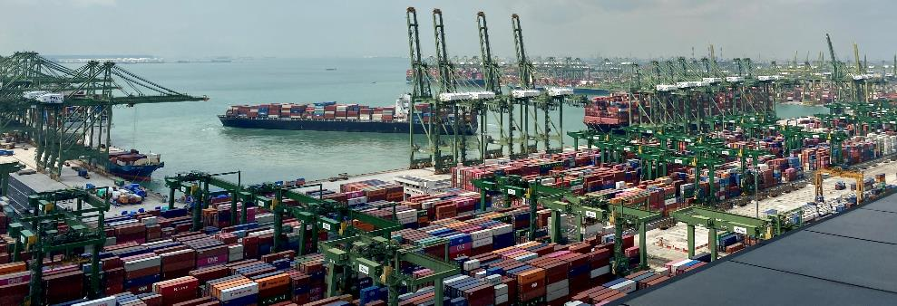
A leader in the global ports and terminal business
ABOUT PSA
90.9 million TEUs in 2022
Group revenue of S$4.67b in 2021
49,000 staff globally
World's Busiest Transhipment Hub
PSA Singapore: 37.0 million TEUs in 2022
(Almost one-seventh of the world‘s total container transhipment throughput)

Slide 6
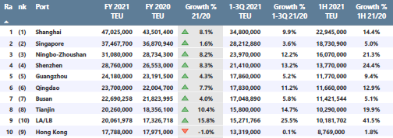
Top 10 global ports in 2021
ABOUT PSA
The Port of Singapore handled 37.5 million TEUs, of which PSA handled 37.2 million TEUs.
Source: Alphaliner
Notes:
Out of top 10 ports: 7 in China, 9 in Asia
Besides Singapore, PSA has a stake in the ports of Guangzhou, Busan and Tianjin.
Source: Alphaliner

Slide 7
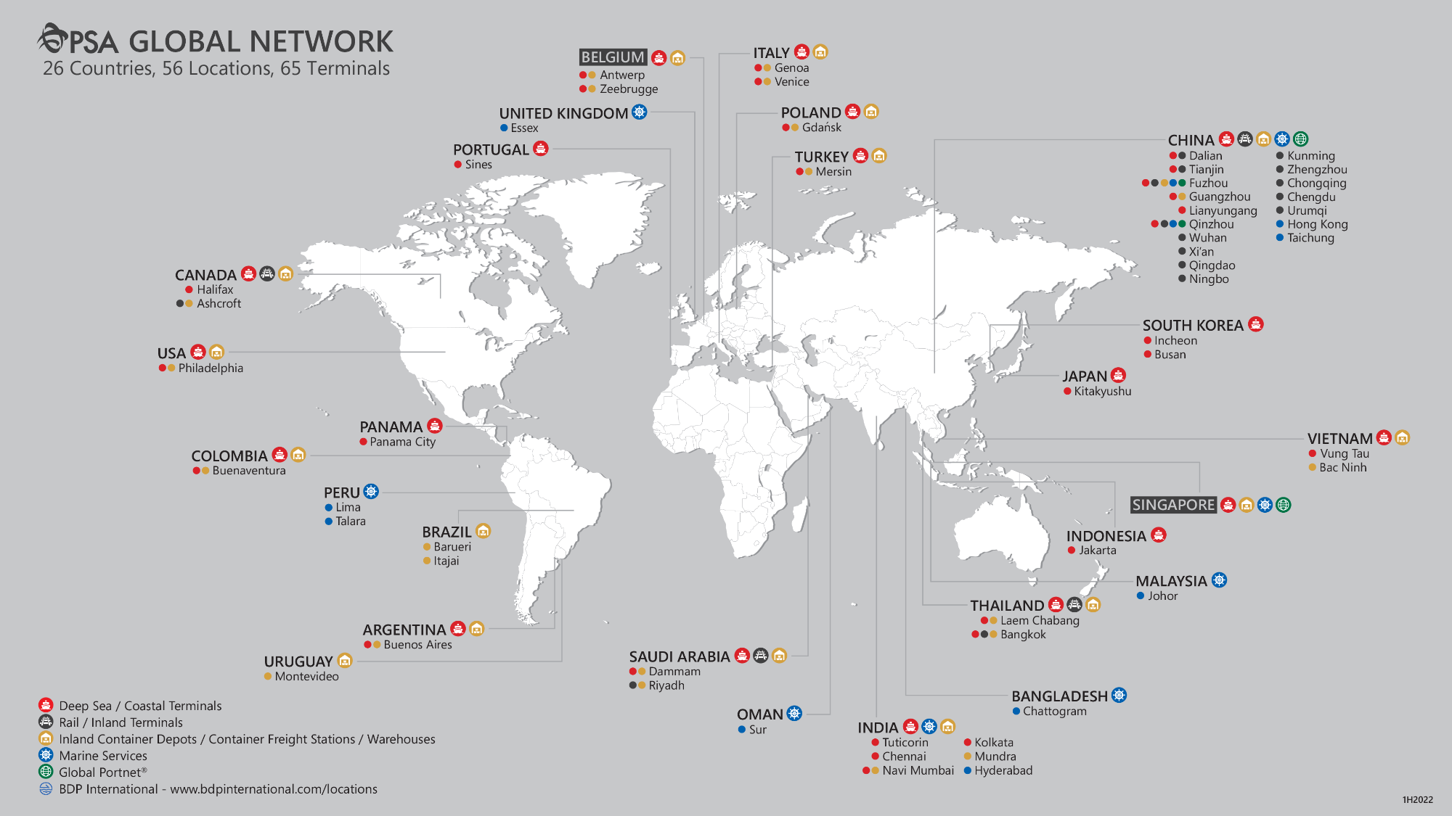
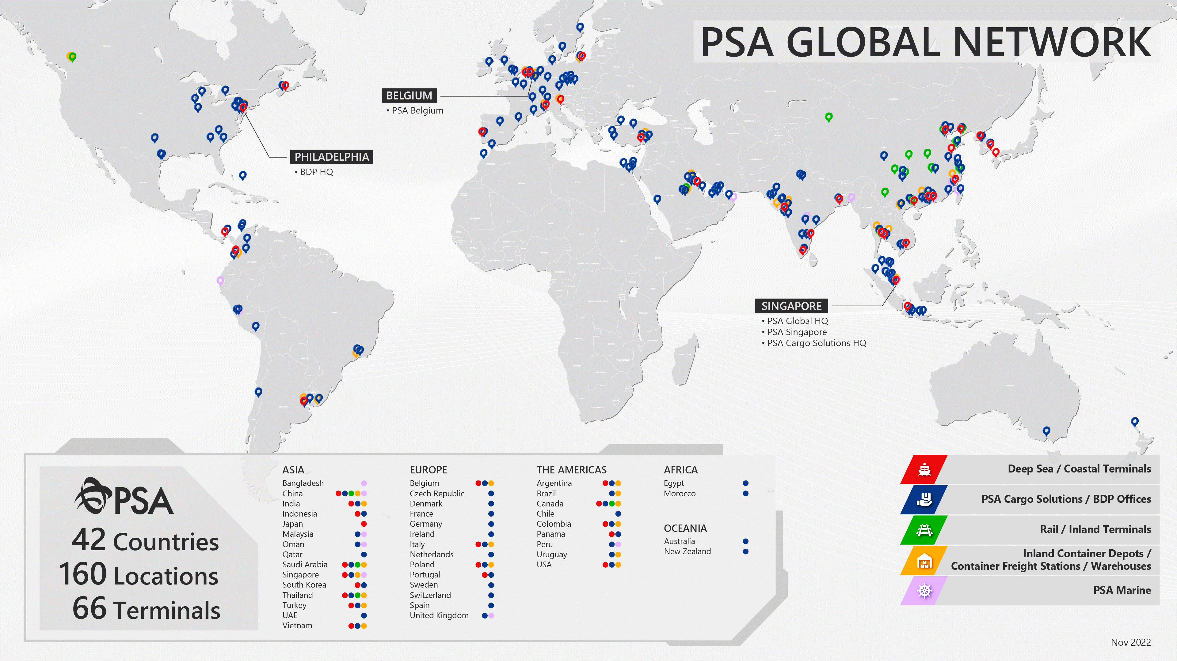
GLOBAL FOOTPRINT: OVER 50 TERMINALS IN 19 COUNTRIES
PSA BDP HQ
Notes:
Over 50 coastal, rail and inland terminals in 19 countries

Slide 8
Chemicals
WHO WE SERVE

Slide 9
We are proven chemical experts
8 of the top 10
55 years
chemical manufacturers call PSA BDP a preferred provider
of handling chemical products
MADE FOR CHEMICALS
50 million
1.6 million
Kgs chemical airfreight
chemical TEUs managed globally
Well-versed in handling
65%
Class 1 to 9
of our business is composed
of chemicals
dangerous goods

Slide 10
Weathering the Storm
Today’s Headwinds & a caveat

Slide 11
IN THE NEWS
West Coast Labor
Rail Safety
Ocean Rates
Ocean Carrier Schedule Integrity
Bunker & Other Fuel
Sourcing Shift
Transpacific Ocean Contracts
China & Taiwan
North / South Rail
Trucking Labor Issues Ahead?

Slide 12
INSTRUCTIONS
Insert a photo
To insert a photo in any picture placeholder, simply click the photo icon and choose the image from your computer. The image will be automatically cropped to fill the space provided.
West Coast Labor

Slide 13
INSTRUCTIONS
Insert a photo
To insert a photo in any picture placeholder, simply click the photo icon and choose the image from your computer. The image will be automatically cropped to fill the space provided.
Ocean Rates & Fuel

Slide 14
INSTRUCTIONS
Insert a photo
To insert a photo in any picture placeholder, simply click the photo icon and choose the image from your computer. The image will be automatically cropped to fill the space provided.
Transpacific Contracts

Slide 15
INSTRUCTIONS
Insert a photo
To insert a photo in any picture placeholder, simply click the photo icon and choose the image from your computer. The image will be automatically cropped to fill the space provided.
CP & KCS Rail Merger

Slide 16
INSTRUCTIONS
Insert a photo
To insert a photo in any picture placeholder, simply click the photo icon and choose the image from your computer. The image will be automatically cropped to fill the space provided.
Rail Safety Issues

Slide 17
INSTRUCTIONS
Insert a photo
To insert a photo in any picture placeholder, simply click the photo icon and choose the image from your computer. The image will be automatically cropped to fill the space provided.
Carrier Schedule Integrity

Slide 18
INSTRUCTIONS
Insert a photo
To insert a photo in any picture placeholder, simply click the photo icon and choose the image from your computer. The image will be automatically cropped to fill the space provided.
Sourcing Shift from China

Slide 19
INSTRUCTIONS
Insert a photo
To insert a photo in any picture placeholder, simply click the photo icon and choose the image from your computer. The image will be automatically cropped to fill the space provided.
China & Taiwan

Slide 20
INSTRUCTIONS
Insert a photo
To insert a photo in any picture placeholder, simply click the photo icon and choose the image from your computer. The image will be automatically cropped to fill the space provided.
Domestic Trucking Unrest

