Slide 1
Relationships in a Digital World
Notes:
1

Slide 2
Overview for Today
Role of Customer Service
Yesteryear
Today – Future
Insight into BDP today

Slide 3
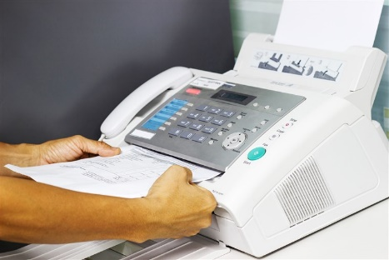
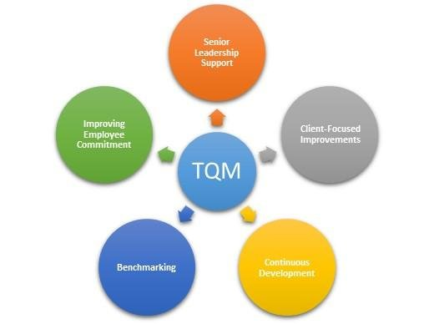
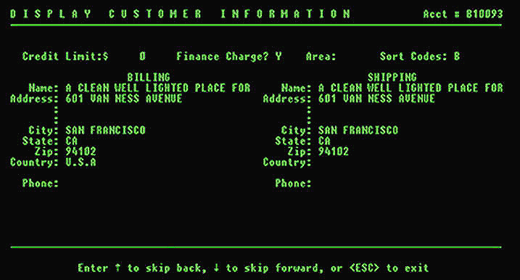
Yesteryear
Mid 90’s study of Customer Service Role
(MIT Study)
One source to get help, Take orders, Solve Issues
Delight Customers
Information about product
Provide Pricing /Sales Support
Institute TQM – Continuous Improvement- Data Collection
Introduce phone answer automation
Notes:
One phone call- away from everything you need
Delight customers- Try to remember what you talked to them about last week
Fax them Material sheets
Pricing – if Prepay and add- have to get back to them
Data collect for TQM – paper check sheets and questionnaire – Voice of Customer
Initially introduce to save customer time

Slide 4
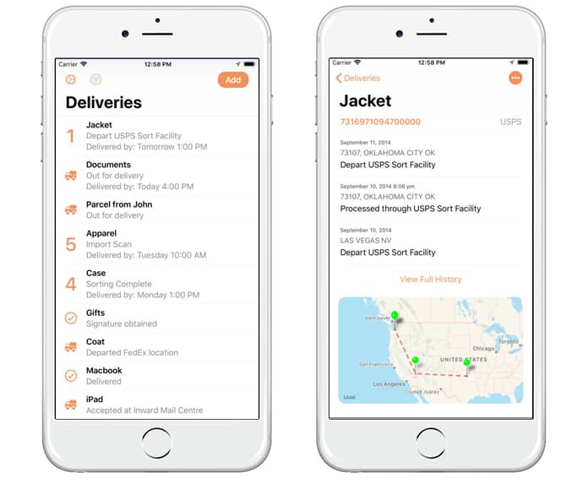
Today – Future
Disruptive ERA
Amazon - Generation
Transaction is self service
I want it now
Mobile Messaging
Expect Pro-Active Action
End to end information
Technology is easy to use
Notes:
We talk about the millenniums - generation z’s Why are they like this – Amazon has caused a big Jump curve in how we think and what we expect.
– we know they will bring big changes in diagnostics and technology and artificial intelligence (AI).

Slide 5
Today - Future
Role of Customer Service
One source to get help
Delight Customers
Information about product
Provide Pricing /Sales Support
Continuous Improvement Supply Chain
Improve Customer Profitability
Notes:
Phone, text, Chat,
Delight Customers – CRM – tickets systems-
Product info on line- todays needs are often specialized
Pricing sales support- Part of the Marketing
Improve the overall supply chain- direct source from International- Distribution Analysis
What is the cost of selling to this customer? – Talk about BBM 2 customers in the top 5 – CWT for one is 8.75 the other 12.50 – Order patterns – consolidations – ability to direct source from plant

Slide 6
Let’s Compare
Yesteryear
Role of Customer Service
One source to get help
Delight Customers
Information about product
Provide Pricing /Sales Support
Institute TQM – Continuous Improvement
Introduce phone answer automation
Today
Role of Customer Service
One source to get help
Delight Customers
Information about product
Provide Pricing /Sales Support
Continuous Improvement Supply Chain
Improve Customer Profitability
What’s Different?
Speed, Accuracy and Financials
How to get there?
Technology, Information, Advanced Analytics

Slide 7
BDP Today
International Freight Forwarder – 148 offices globally, 2.4 Million transactions per year
In business 52 Years.
2015 Introduce North American Division

Slide 8
BDP Today
North American
TECHNOLOGY
SOURCING &
EXECUTION
FREIGHT PAY AND AUDIT
BENCHMARK &
ANALYTICS
MANAGED
SERVICES

Slide 9
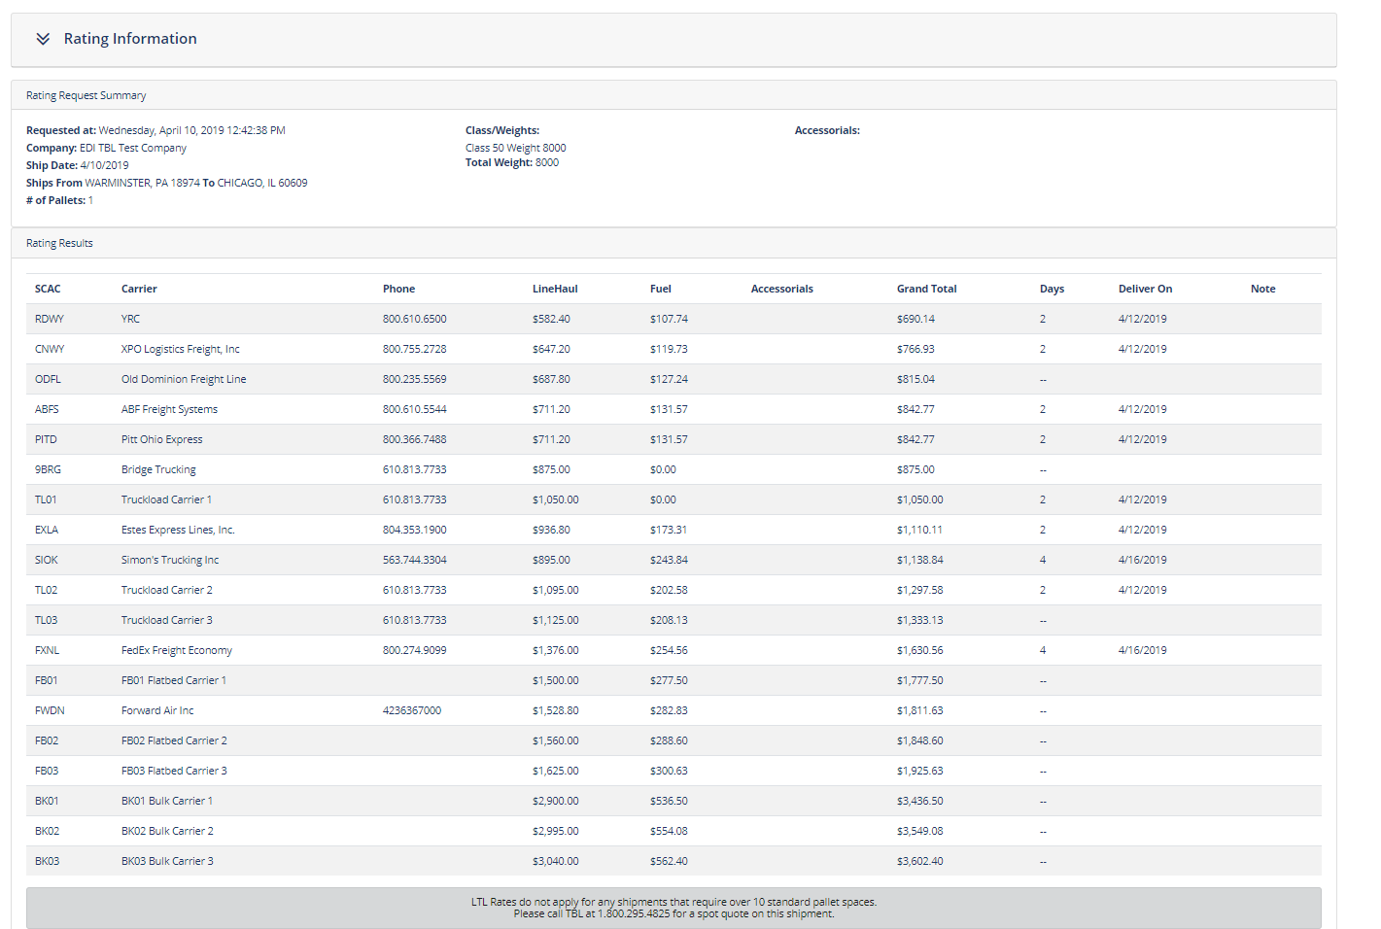
BDP North America
Easy access to rates and service
Notes:
Desk top available or direct connect to ERP

Slide 10
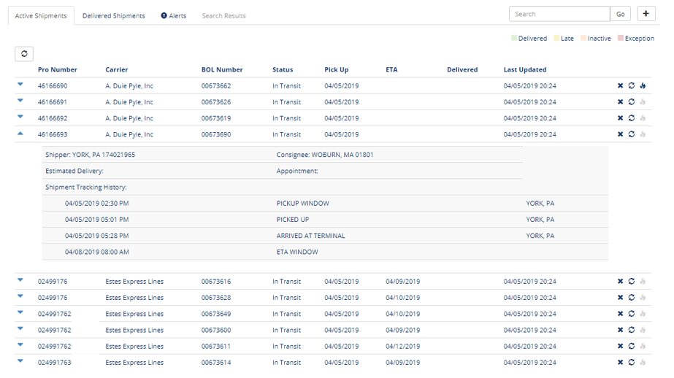
BDP North America
Real Time Visibility
Notes:
Where is my shipment now
Drill down

Slide 11
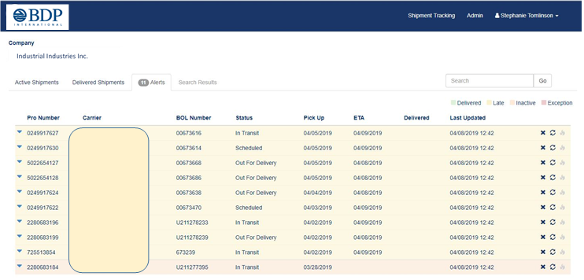
BDP North America
Managing the Alerts

Slide 12
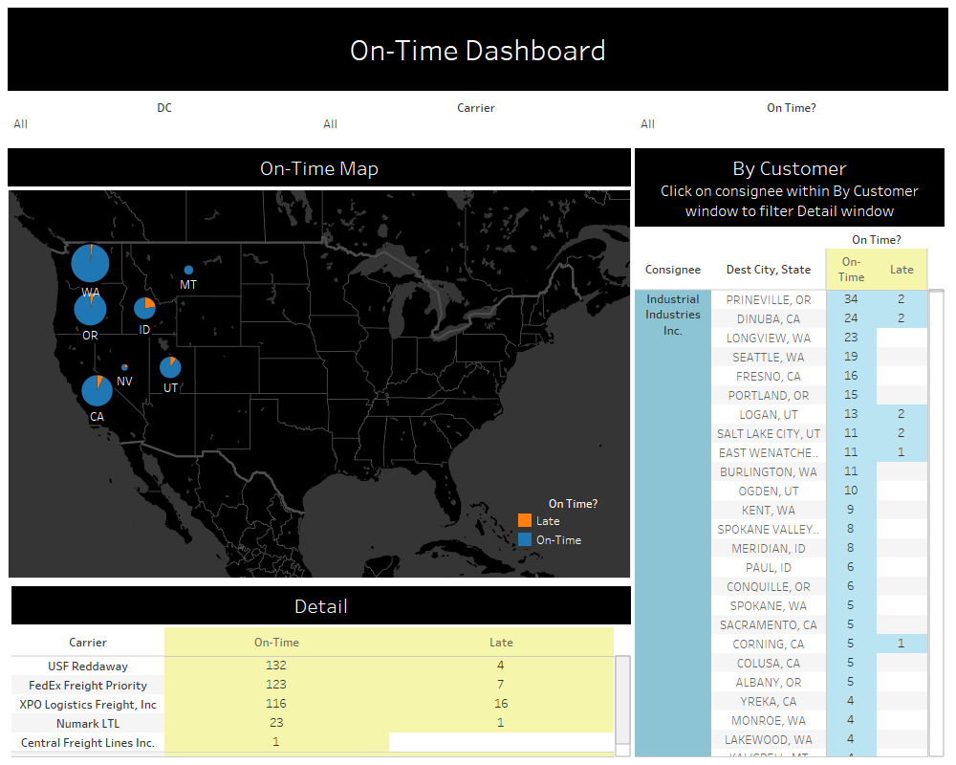
BDP North America
Customer Level Reporting for QBR

Slide 13
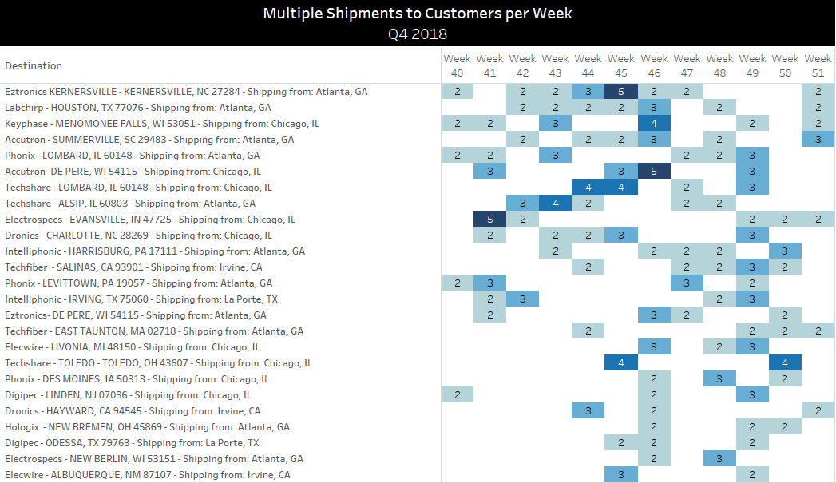
BDP North America
Customer Profitability
Notes:
Some of what spoke about earlier

Slide 14
Thank-you
LOGISTIC SOLUTIONS-
DRIVING PROFITS TO YOUR BOTTOM LINE

Slide 15
Questions ?

