Slide 1
Getting the Most Out Of Your Multigenerational Team
2017 CCSMG Spring Conference
May 2017

Slide 2
What generations are involved?
Baby Boomers Born 1945-1964 78.8M
Generation Xers Born 1965-1984 65.8M
Millennials Born 1985-2004 83.1M
Generation Y/Z
Why is this important?

Slide 3
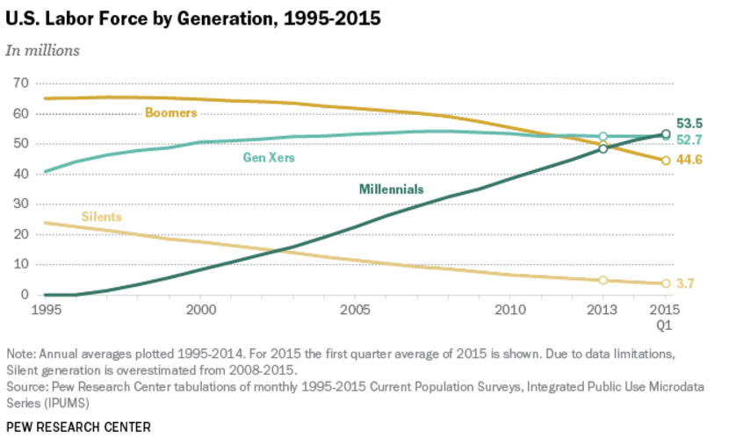

Slide 4
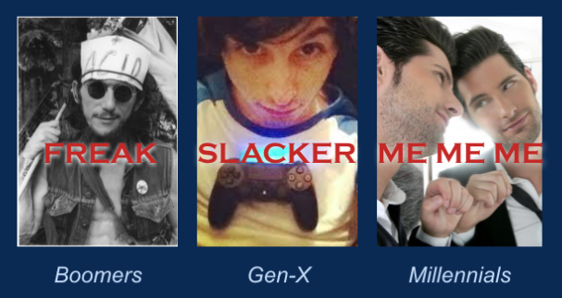

Slide 5
How we were shaped¹ Parents/grandparents wwii great depression boomers JFK assassination civil rights sexual revolution hippies landing on the moon Vietnam war significant social change gen x berlin wall mtv latchkey kids divorce corporate scandals challenger explosion Double digit inflation aids millennials 9/11 attacks social media school shootings y2k technology terrorism helicopter parents

Slide 6
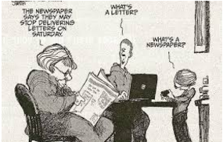
Who are we? Reality or Stereotype Boomer Gen X Millennial

Slide 7
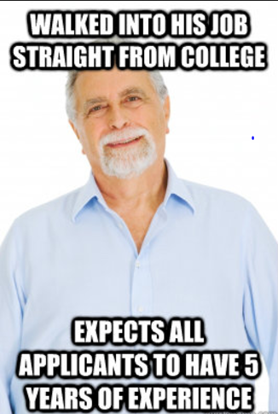

Slide 8
stereotypes – boomers Not good with technology Not interested in change inflexible reality Sometimes the first in line for new technology Steve jobs and bill gates – boomers use tablet devices 20% more than Gen x’ers always intrigued about the latest gadget have the purchasing power LIKE CHANGE – BUT ON THEIR TERMS competition to succeed INGRAINED their idea of the work Ethic

Slide 9
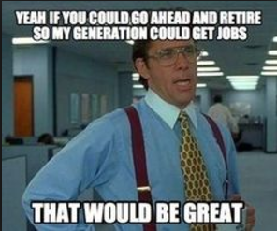

Slide 11
stereotypes – Gen x Negative cynics slackers whiny Reality they are realists push back and ask tough questions they care prefer blunt and honest communication independent and entrepreneurial

Slide 12
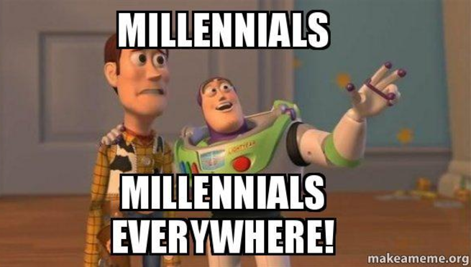

Slide 13
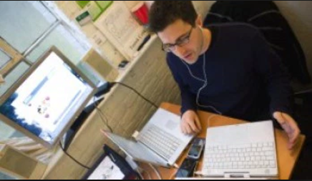
stereotypes – millennials slackers – don’t want to perform “menial” tasks need constant attention don’t know proper behavior to show respect self-centered/narcissistic reality energetic and creative confident believe in equality entrepreneurial Need to know how they effect the company require feedback

Slide 14
What really drives your millennial employees?
Flexibility – Do they really need to be present to get the job done?
Can do work through connectivity
Set their own schedules
Want to Learn and Continue to Learn
Want to grow professionally and personally Travel!!!!
Wants learning experiences that reflect their interests and their passions
Want to be Part of the Solution
Listen to them
Help them understand how they fit into the organization
Align personal goals to the goals of the organization

Slide 15
opportunities for customer service groups – millennials and customers
How Managers Can Help Employees Be the Best in Customer Service roles – It will carry over into all other jobs they ever have!
Be Present - Make Yourself Available
Listen More Than You Talk
When Speaking or Writing, Be Mindful of the Words Chosen
Don’t Extemporize
Ask for Feedback
Be a Problem Solver

Slide 16
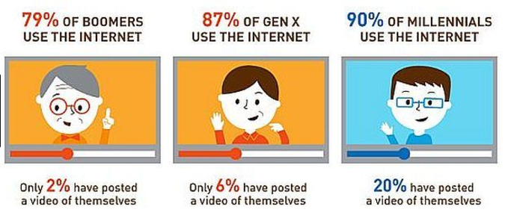
How are we alike?

Slide 17
What do we like about each other? How are we alike? Every generation believes they can change the world all generations have felt entitled or special If you only knew what I had to go through… share vs teach – we all have been in each other’s shoes we just have different experiences getting there “Change is hard, but unstoppable; be accepting of change and grow from it. Learn from the younger generations even though we think it should be the other way around.” https:www.linkedin.com/pulse/baby-boomers-millenneals-have-more-in-common-than-you-abby-Morningstar

Slide 18
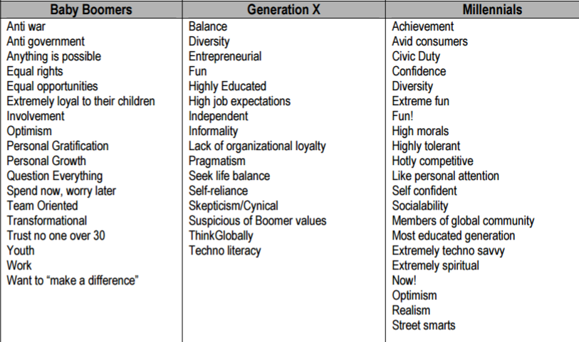
Humor in the workplace – core values www.wmcf.org/uploads/generationaldifferenceschart

Slide 19
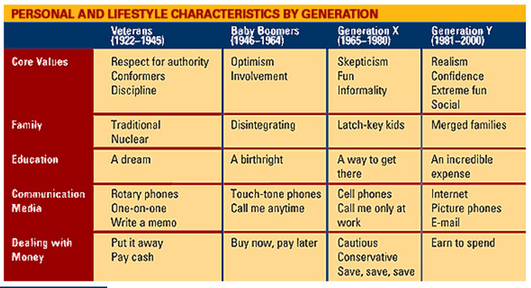
Speaking of core values www.FDU.edu/nespubs/magazine/05ws/generations.htm

Slide 20
What can managers do?
Get to know your employees
Find out what motivates them
Learn from them
Listen to them
At the very least, learn how employees best like to communicate

Slide 21
The importance of feedback Now more than ever before, immediate and frequent feedback is imperative Focus on guidance – Radical candor https://www.youtube.com/watch?v=rfgu0hohcce

Slide 22
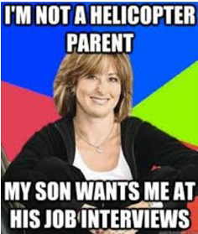

Slide 23
What can companies do? Recognize there are differences Provide training the Myers-briggs personality test true colors® empower managers to build in flexibility

Slide 24
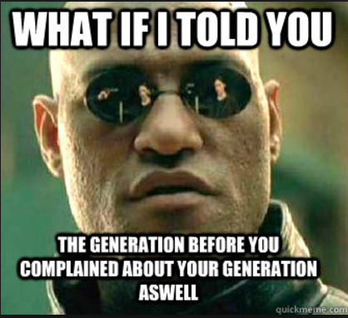

Slide 25
Sources ¹Generations in America, https://www.re-generations.org/tag/generational-theory/ carroll, Anna, mssw, The feedback imperative - How to give everyday feedback to speed up your team’s success. Austin: river grove books, 2014. print. Hagemann, bonnie and gronbach, Kenneth w., decades of differences - making it work. Haddam, ct.: Kenneth gronbach, 2014. print. Gronbach, kenneth w., the age curve – how to profit from the coming demographic storm. New York: Amacom books, 2008. print. 3 common generational stereotypes, https://www.mncpa.org/publications/footnote/2014-04/3-common-generational-stereotypes.aspx

Slide 26
Sources continued
The Myths and Reality of the Workplace Generational Divide, http:www.huffingtonpost.com/meghan-m-biro-/the-myths-and-reality-of-_b_8537830.html
3 things millennials want in a career, http://fortune.com/2015/03/26/3-things-millennials-want-in-a-career-hint-it-is-not-more-money/
www.wmcf.org/uploads/generationaldifferenceschart

