Slide 1
Let's Talk About Soft Skills Customer Service Communication in the Chemical Industry
Ellen Bland
Service Evolution LLC

Slide 2
Agenda
Antitrust
Communication Devolution
Where we are today
What it means
Discussion
Email: The Good, The Bad and The Ugly
Things to consider
What can go wrong
Discussion
Wrap Up

Slide 3
Antitrust Guidelines
While some activities among competitors are both legal and beneficial to the industry, group activities of competitors are inherently suspect under the antitrust laws. Agreements or combinations between or among competitors need not be formal to raise questions under antitrust laws, but may include any kind of understanding, formal or informal, secretive or public, under which each of the participants can reasonably expect that another will follow a particular course of action.
Each of us is responsible to see that topics which may give an appearance of an agreement that would violate the antitrust laws are not discussed during this or future meetings. It is the responsibility of each participant to avoid raising improper subjects for discussion. This reminder has been prepared to assure that participants in meetings are aware of this obligation.
The Dos and Don’ts presented on the next slide highlight only the most basic antitrust principles. Each participant in this meeting should be thoroughly familiar with his/her responsibilities under the antitrust laws and should consult counsel in all cases involving specific situations, interpretations, or advice.

Slide 4
Antitrust Continued
DO
Adhere to prepared agendas for all meetings and object any time meeting minutes do not accurately reflect matters that transpired.​
Understand the purpose and authority of the group.​
Consult with your company counsel on antitrust questions relating to meetings.
Protest against any discussion or meeting activities which appear to violate the antitrust laws; disassociate yourself from any such discussion or activities and leave any meeting in which they continue.
DON’T
Do not, in fact or appearance, discuss or exchange information regarding:​
​
Individual company prices, price changes, price differentials, mark-ups, discounts, allowances, credit terms, etc., or data that bear price, e.g., costs, product, capacity, inventories, sales, etc.​
Industry pricing policies, price levels, price changes, differential, etc.​
Changes in industry product, capacity or inventories.​
Bids on contracts for particular products; procedures for responding to bid invitations.​
Plans of individual companies concerning the design, production, distribution or marketing of particular products, including proposed territories or customers.​
Matters relating to actual or potential individual customers or suppliers that might have the effect of excluding them from any market or of influencing the business conduct of firms toward such suppliers or customers.​
Do not discuss or exchange information regarding the above matters during social gatherings incidental to meeting, even in jest.
​

Slide 5
Topic 1-
Communication Devolution
OR
No One Talks Anymore!
Hey, Bob!
Pick up,
Would ya?
What's that strange noise??

Slide 6
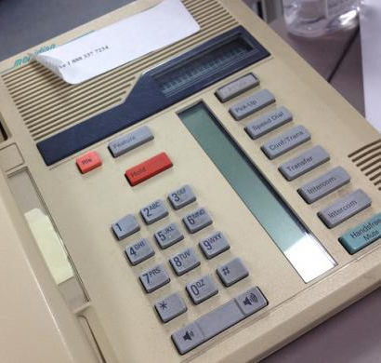
Maybe You Remember When...
Customers phoned their orders in
CSRs spent most of their time on the phone
There was a lot more chatting between customers and CSRs
In general, people spoke on the phone more often
This Photo by Unknown author is licensed under CC BY-SA.

Slide 7
Today Things Are Different
Customer orders come in through various service channels
CSRs speak with customers less, not more
Email tends to be the primary communication channel between CS and the customer
When there is personal interaction, it's often due to a problem
This Photo by Unknown author is licensed under CC BY-ND.

Slide 8
The Human-To-Human Contact Has Never Been More Potent!
Think of your personal life...
Text much?
Shop on-line?
Bank on an app?
Medical information on a portal?
Will you do almost anything to not have to place a call?
Your customers don't want to have to call you! They're likely already upset!

Slide 9
The Power of the Personal Conversation: One Chance to Get It Right
When a customer calls voice-to-voice or face-to-face, they're very likely seeking a resolution to a time-sensitive problem
The customer is using their own valuable time – other work is waiting
When a customer is asked to repeat information to several people, frustration will escalate
Listening and empathy are key
For discussion:
Are your team members trained to handle a voice or Teams call from an upset customer call? Do you have a script or checklist?
Does your team have a documented protocol for communication during real-time customer grievances?

Slide 10
Topic 2 - Email The Good The Bad & The Ugly

Slide 11
Email: The Good, the Bad...
The Good
Email creates a permanent record
The sender can say exactly what they want
Email can be a great way to send documents and specific information
Email is dated and time stamped
Email platforms have lots of bells and whistles to keep us organized
The Bad
Email creates a permanent record
Not everyone has the gift of the written word
Email can be an unfortunate way to lose the original intent of a message and really confuse people
The volume of email is often overwhelming
Many people are not familiar with email functionality

Slide 12
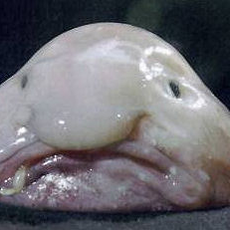
AND... THE UGLY
"But I emailed him!"
"You were copied!"
"Sorry, Ms. Customer, I didn't see your email"
Out of Office Auto Reply: "I'm currently out of the office. Please call 800-555-5555. Thank you."
The Free-for-All-Signature:
John Smith
Customer Service Representative
Apex Chemical Company
Live Free or Die!
The 10-page email with a permanent subject line
For discussion:
What are your pet peeves?
What are your best practices for ensuring customer communications are crisp, clear and professional
Is your team trained on email protocol?
This Photo by Unknown author is licensed under CC BY-NC-ND.

Slide 13
Wrap Up
Comments/Questions?
Recommendations for in-depth soft-skills training:
Telephone Doctor – Nancy Friedman
serviceskills.com
telephonedoctor.com
Other recommended resources?
Chemicals Customer Service process improvements
www.Serviceevolutionllc.com
Or email Ellen@serviceevolutionllc.com
Other topics you like to see CCSMG Focus Groups Offer?
This Photo by Unknown author is licensed under CC BY-SA-NC.

