Slide 1
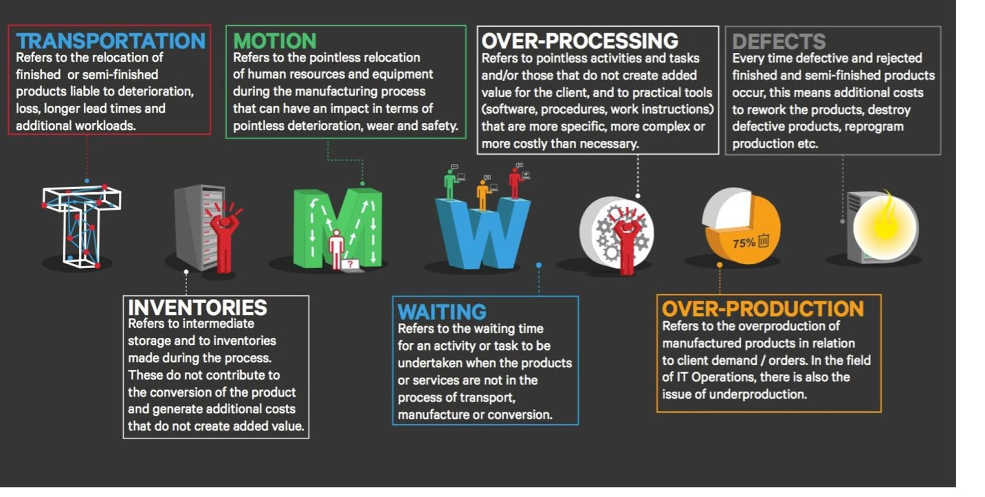
Wastes to look for at your “Go Sees”
https://www.google.com/url?sa=i&rct=j&q=&esrc=s&source=images&cd=&cad=rja&uact=8&ved=0ahUKEwiHjNvN_-fTAhUMEywKHc9DC6gQjRwIBw&url=http%3A%2F%2Fautomicblog.sys-con.com%2Fnode%2F3348441&psig=AFQjCNGoDOjQ9YqNxfobDs2CP95XzjR2Rw&ust=1494597471356997

Slide 2
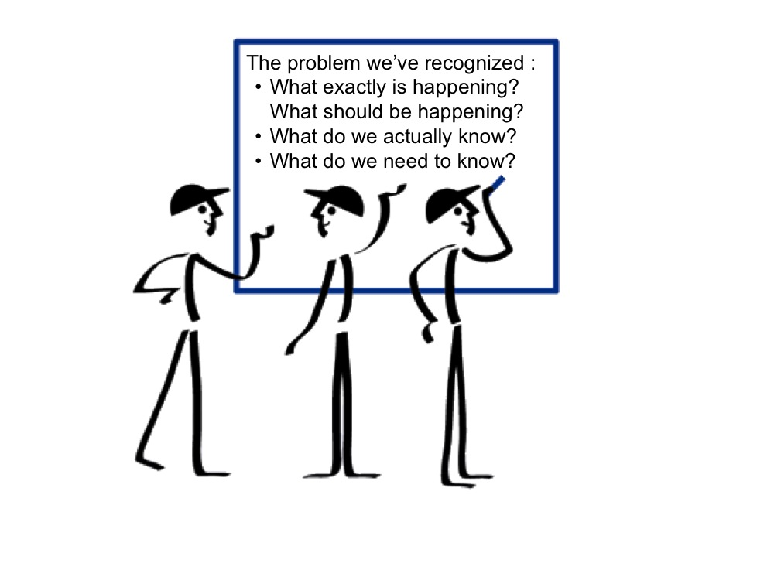
Problem Discovery Phase – Initial questions
https://www.google.com/url?sa=i&rct=j&q=&esrc=s&source=images&cd=&cad=rja&uact=8&ved=0ahUKEwjugcCsgujTAhWCZCwKHd0MAWsQjRwIBw&url=https%3A%2F%2Fwww.lean.org%2FWorkshops%2FWorkshopDescription.cfm%3FWorkshopId%3D117&psig=AFQjCNGqkUZnew0vx289A8eaiC4EB5UOSQ&ust=1494598208406539

Slide 3
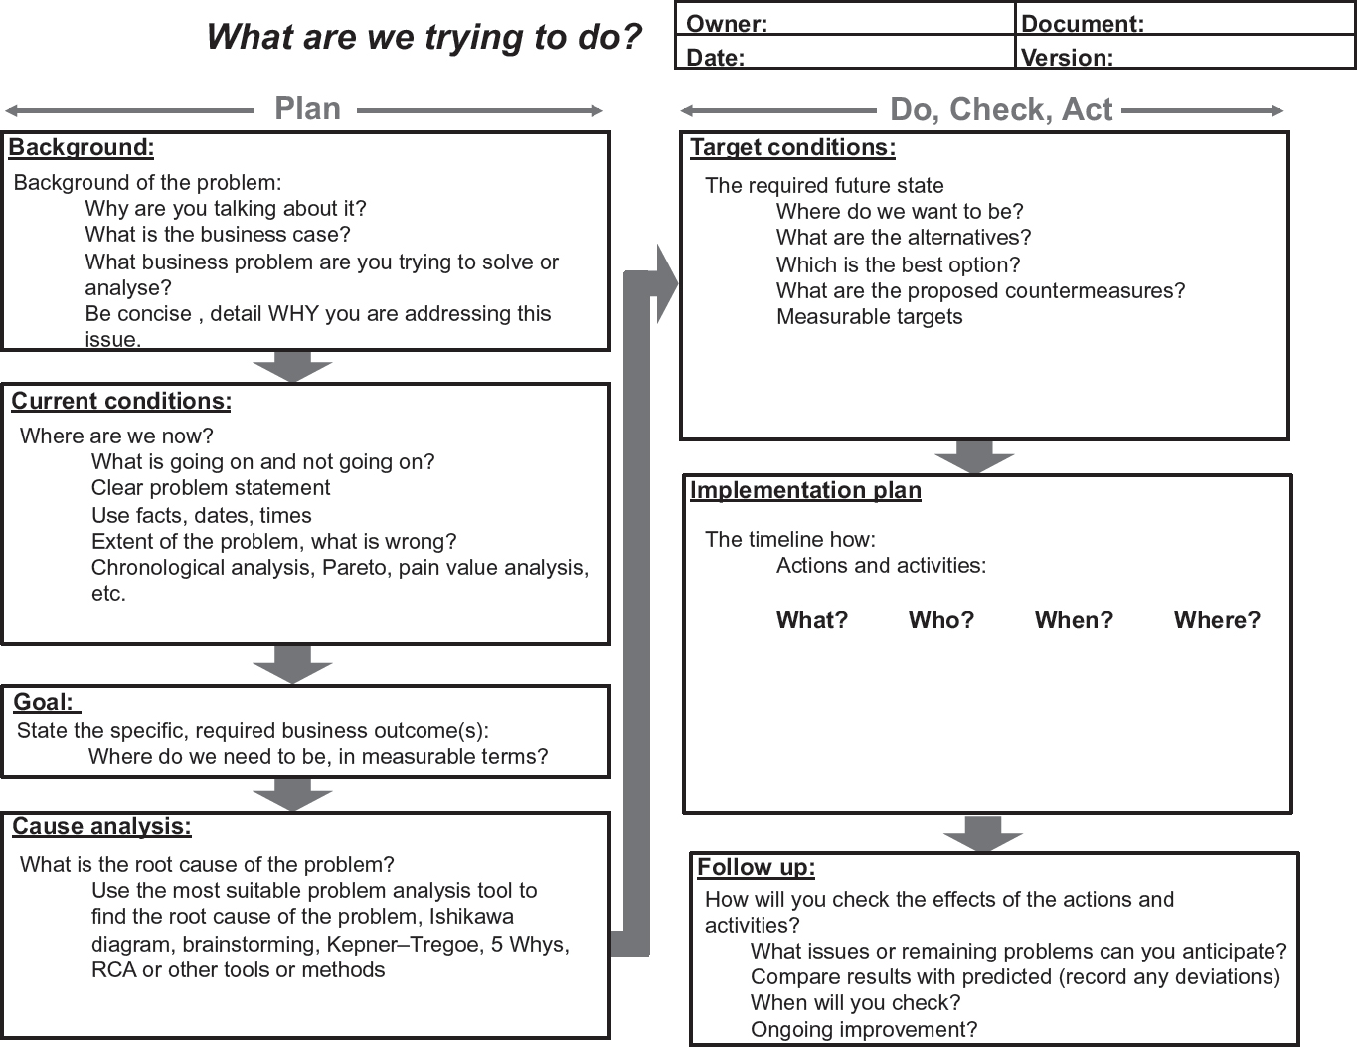
A3 Problem Solving template
https://www.google.com/url?sa=i&rct=j&q=&esrc=s&source=images&cd=&cad=rja&uact=8&ved=0ahUKEwi4nojTgejTAhXDDywKHR7MDqsQjRwIBw&url=http%3A%2F%2Fwww.keyword-suggestions.com%2FYTMgcHJvYmxlbSBzb2x2aW5n%2F&psig=AFQjCNF1erl971oobvPP_2eSyIwGaR7IDg&ust=1494597988992575

Slide 4
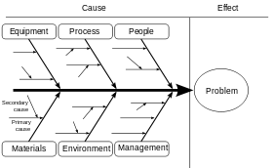
Fishbone Diagram
https://www.google.com/url?sa=i&rct=j&q=&esrc=s&source=images&cd=&cad=rja&uact=8&ved=0ahUKEwij_p6CgujTAhVIBiwKHWEABRwQjRwIBw&url=https%3A%2F%2Fen.wikipedia.org%2Fwiki%2FIshikawa_diagram&psig=AFQjCNHehIDuuVKV0gh45T_MpvOo9OUOQg&ust=1494597537402604

Slide 5
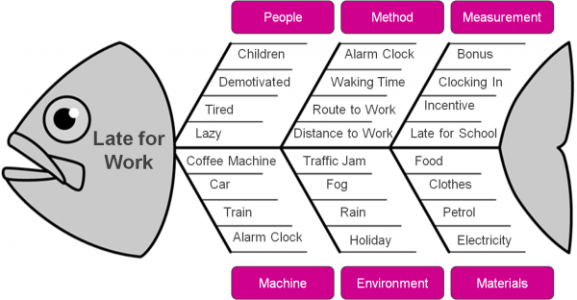
Example of Fishbone Diagram for problem solving
https://www.google.com/url?sa=i&rct=j&q=&esrc=s&source=images&cd=&cad=rja&uact=8&ved=0ahUKEwiF9p-UgOjTAhVLjSwKHdC8BqgQjRwIBw&url=http%3A%2F%2Fwww.squawkpoint.com%2F2012%2F01%2Ffish-bone-diagrams-helpful-or-not%2F&psig=AFQjCNHehIDuuVKV0gh45T_MpvOo9OUOQg&ust=1494597537402604

