Slide 1
Continuous Improvement
Cristina Barillas
Sean Charles

Slide 2
Submarine Captain
https://www.youtube.com/watch?v=OqmdLcyES_Q

Slide 3
Americas CI Management System
True North (Business Objectives)
Customer Center and Business Partner Goals
Standard Work
People Development (CI Skills)
Leader standard work related to coaching, daily gemba walks, and reflection
Appropriate design and use of SOPs
Building problem solving capability; awareness and accountability for performance
Visual Management
Visual display boards with data on performance, problems and actions being taken to improve
Use of other visual controls where applicable

Slide 4
Why do you do this?
Empowerment
Proactivity
Raising Issues prior to becoming an emergency
Value Creation
Team Collaboration
Open Discussion
Best Practice Sharing
Free up time

Slide 5
Get started!
Determine what are you trying to accomplish? (Business Results / Behavioural / Cultural Change)
Should have no more than 3 targets at any one time.
Best Practice (2 Business Results Targets & 1 Behavioural / Cultural Target).
Define Preliminary Stakeholder Map.
Who is a supporter, who is sceptical of success.
This is a good place to determine your starting point.

Slide 6
Examples of Value Focus Areas
HSSE & Compliance challenges
Order issues; Contract Compliance, Revisions / Internal Changes
Invoice Accuracy
Overdues
Escalation items that are causing road blocks for the team to do their job.

Slide 7
Health Check: How are you doing?
Re-evaluate the stakeholder map. Has there been change?
Look at tracking items like:
Issues raised by individual
Attendance
# of items resolved
Business Target change
Are you seeing change in the Culture / Behaviour?
This takes time, be patient. When it starts to shift it will move quickly. Success and support from the leaders to clear issues helps to gain trust. This will create more focus by the team on the desired business targets.

Slide 8
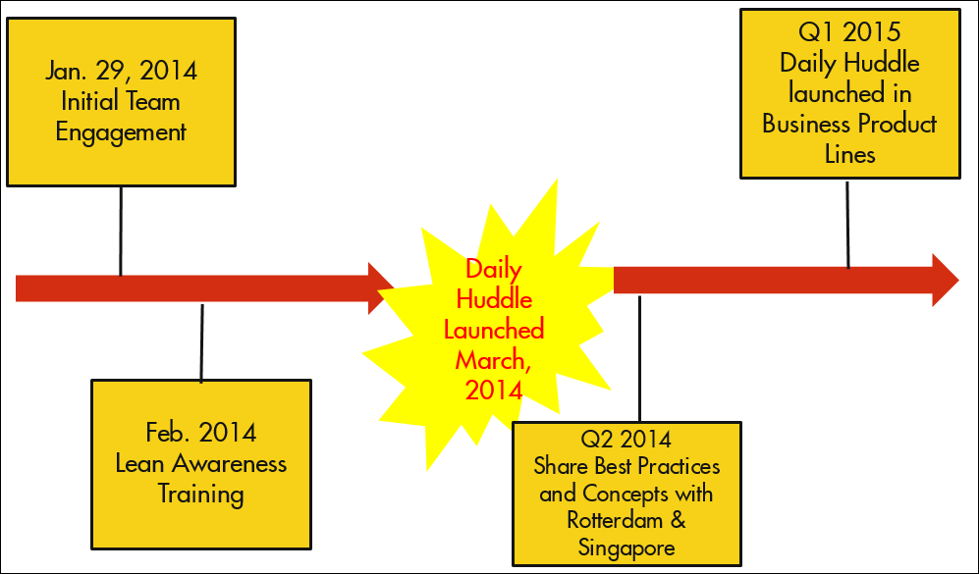
Sample Continuous Improvement Journey

Slide 9
CI Team Accomplishments
Collecting overdues: Over $100MM back in working capital for collections
Freight not being invoiced in excess of $1.5MM identified & billed back
Solvents reduction in cancelled orders by 50% estimated value leakage of $1.3MM
Invoice Accuracy (IA) projects (individual and consolidated billing) sustainably improved the IA KPI from average of below-target 92% to above target 98%
Carrier Utilization project: A reduction in value leakage of$540,000

Slide 10
Final Thoughts
Be Patient, “you will go slow to go fast.”
“Don’t dread the red,” support the team and look for quick wins early, the “green KPI’s will come.”
Perfection is a journey not a destination. Support the team let them learn to solve their own issues, and failure to solve and escalation, are good things. Praise them for raising the issue.
Celebrate your success. This is key, especially early on. No matter how small make sure that you recognise the wins and do something fun with the team, to let them know you appreciate them solving their issues and raising the results.

Slide 11
Q&A

