Slide 1
The Evolution of the Customer Service Role
Mark Andersen | Esker

Slide 2
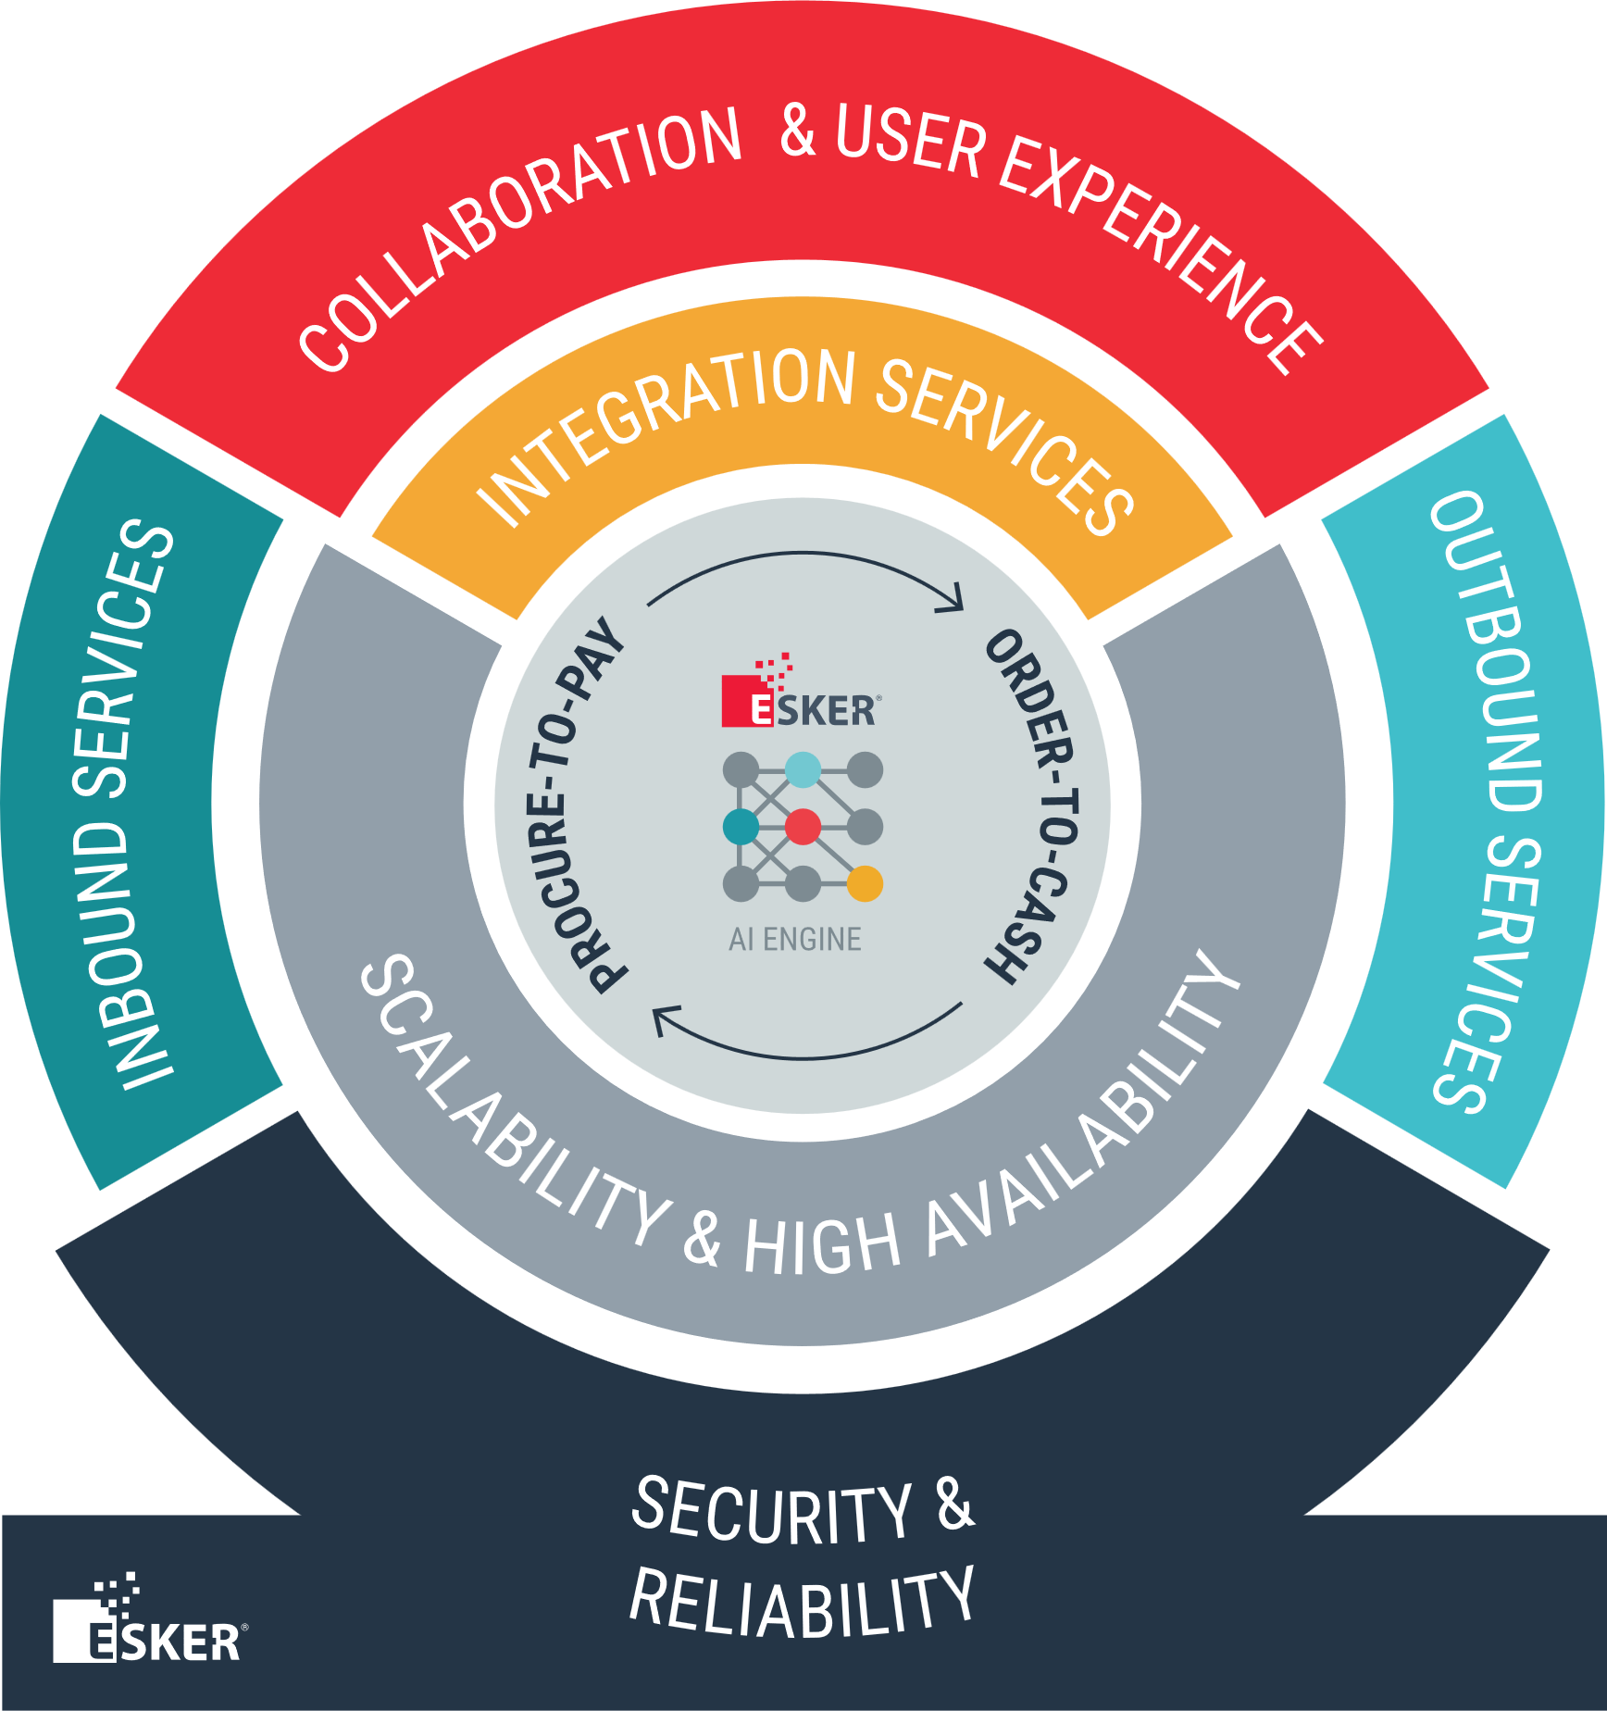


YOU’RE IN GOOD HANDS WITH ESKER
4M+
1+ billion PLATFORM PROCESSES
6,000+
customers
INVOICES PROCESSED PER MONTH
2M+
PERFORMED in 2019
Implemented on one single platform
ORDERS PROCESSED PER MONTH
1M+
EDI DOCUMENTS PROCESSED PER MONTH
900+
man-years
600K+
users
10M+
15%
15%
FAX PAGES PRODUCED PER MONTH
Spent in r&d building the platform
On one single platform
20M+
MAIL PAGES PRODUCED PER MONTH

Slide 3

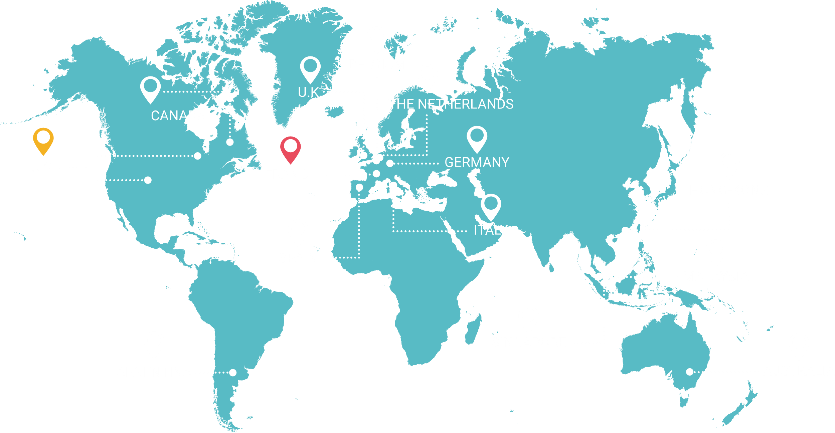

Worldwide Presence
Lyon, France — Headquarters
Derby, U.K.
Munich & Dusseldorf, Germany
Madrid, Spain
Milan, Italy
Brussels, Belgium
Amsterdam, The Netherlands
Madison, WI & Denver, CO, U.S.
Montreal, Canada
Buenos Aires, Argentina
Sydney, Australia
Singapore
Hong-Kong
Kuala Lumpur, Malaysia

Slide 4
ONE interface ONE platform
PROCURE-TO-PAY
ORDER-TO-CASH
SUPPLIER
CASH
CONTRACT
CLAIMS &
SOURCING
MANAGEMENT
MANAGEMENT
MANAGEMENT
ACCOUNTS
MANAGEMENT
COLLECTIONS
INVOICE
ESKER PLATFORM
APPLICATION
DEDUCTIONS
DELIVERY &
EXPENSE
CUSTOMER
ORDER
CREDIT
PAYABLE
COMPLIANCE
MANAGEMENT
PROCUREMENT
MANAGEMENT
& COMPLIANCE
INQUIRY
MANAGEMENT
Your
suppliers
Your
company
Your
customers
<<< Your cashflow
Your cashflow >>>
Esker is the only cloud platform to automate the entire Order-to-Cash & Procure-to-Pay cycles
Platform box is removable

Slide 5



The Impact of Automation on Customer Service
Free up time
Serve customers
Improve collaboration
Serve employees
Lower cost-to-serve
Increase opportunities
for employees to focus on upselling and relationship building.
with a more engaged and satisfying experience.
and decision making via custom dashboards and analytics.
by creating a less stressful, more fulfilling work environment.
by removing costly errors and manual bottlenecks.
for new and/or recurring business.
Why now? Changing customer expectations, supply chain disruptions and economic instability make Customer Service more important than ever before.
Notes:
Why Customer Service Matters:
Changing customer expectations, supply chain disruptions, economic instability. Once viewed as a cost center focused on transactional problem-solving, customer service is now being looked to as a value-generating operation expected to contribute to long term business growth.

Slide 6








ORDER PROCESSING COSTS
ERROR
RATES
Order
Processing
SLAs NOT MET
CHALLENGES
LIMITED PROCESS VISIBILITY AND CONTROL
CUSTOMER
DISSATIFACTION
TALENT MANAGEMENT
& RETENTION
Notes:
High order processing costs: process is not efficient and thus time and money consuming
High error rates: due to manual data entry, errors are made resulting in incorrect product deliveries and customer returns
SLAs: unable to deliver on the service engagements
All of that leads to dissatisfied customers who are more likely to order from the competition
Also, the employee dissatisfaction: customer service team has a low morale because people are spending lots of time on low-value activity and are not valued according to their capabilities and importance in the company, and thus it’s difficult to recruit and retain talents
And finally, the control and visibility over the order process is limited and it’s difficult to improve what you can’t measure.

Slide 7

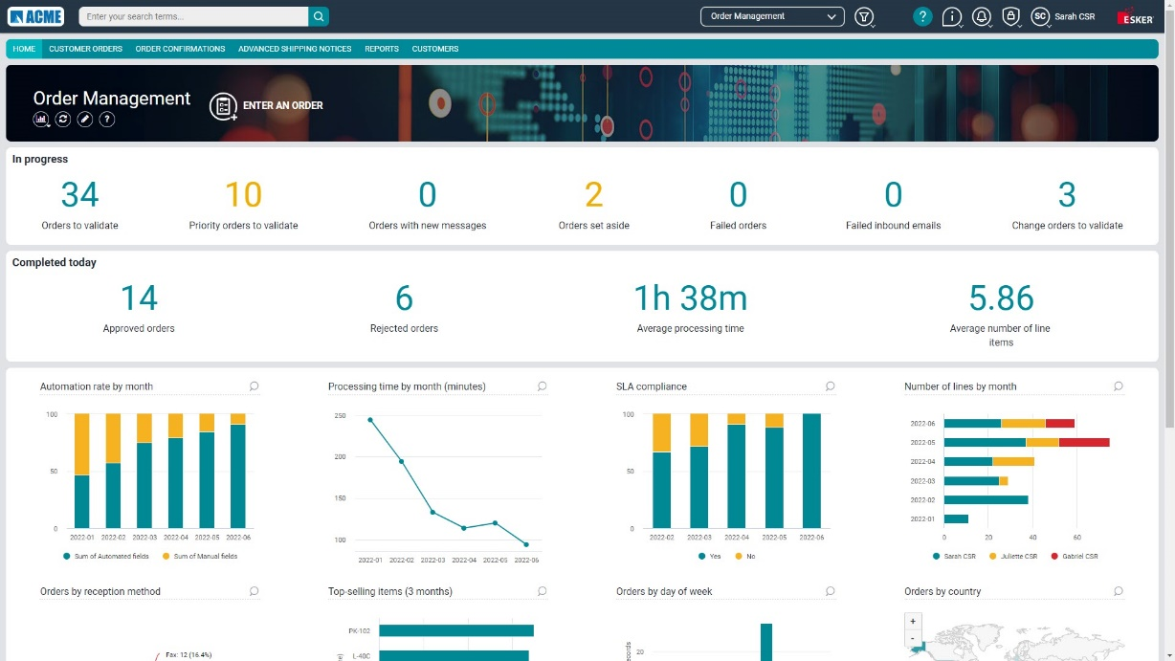

SOLUTION FEATURES
BEHIND THE BENEFITS
DASHBOARDS & ANALYTICS
ORDER TRIAGE
ERP INTEGRATION
Identification of orders
in an email flow with
AI classification
Integration with any
ERP system via APIs
or flat files
AI-DRIVEN RECOGNITION
DATA VALIDATION &
ARCHIVING
Machine and deep learning technology to automatically extract data from orders
Ensure PO Data is accurate and PO and reportable data are retained for compliance.
COLLABORATION & COMMUNICATION
ORDER CONFIRMATION & ADVANCED SHIP NOTICES
Clarify orders via tracked conversations, both internally & with customers
Deliver confirmations according to customer preferences (email, portal and/or EDI)
Instant access to order processing KPIs and performance trends
ANY CHANNEL, ANY FORMAT
One single solution to receive and process fax, email, EDI, E-commerce, portal & mobile orders
Notes:
So how do we achieve those customer results and benefits?
Thanks to a comprehensive set of features to help customer service people work smarter rather than harder.
1 – Any channel
2 – Order triage for email channel
3 – AI recognition
4 – Collaboration
5 – ERP integration
6 – Confirmations
7 - Dashboards

Slide 8

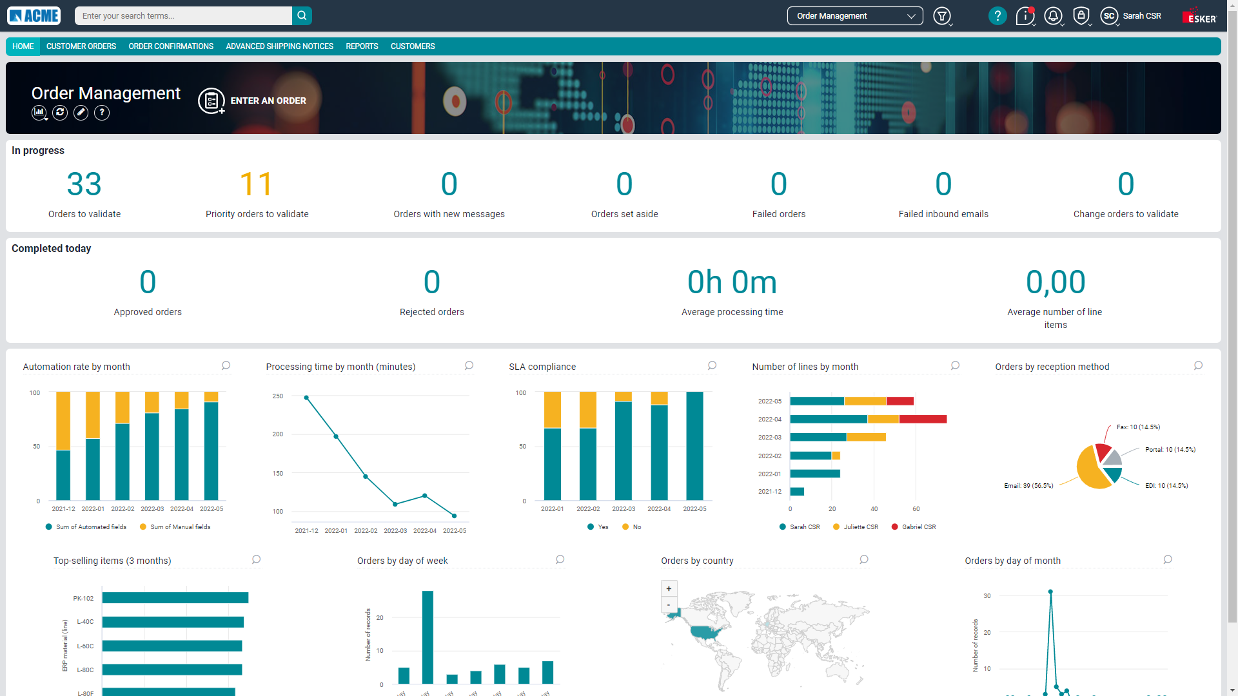

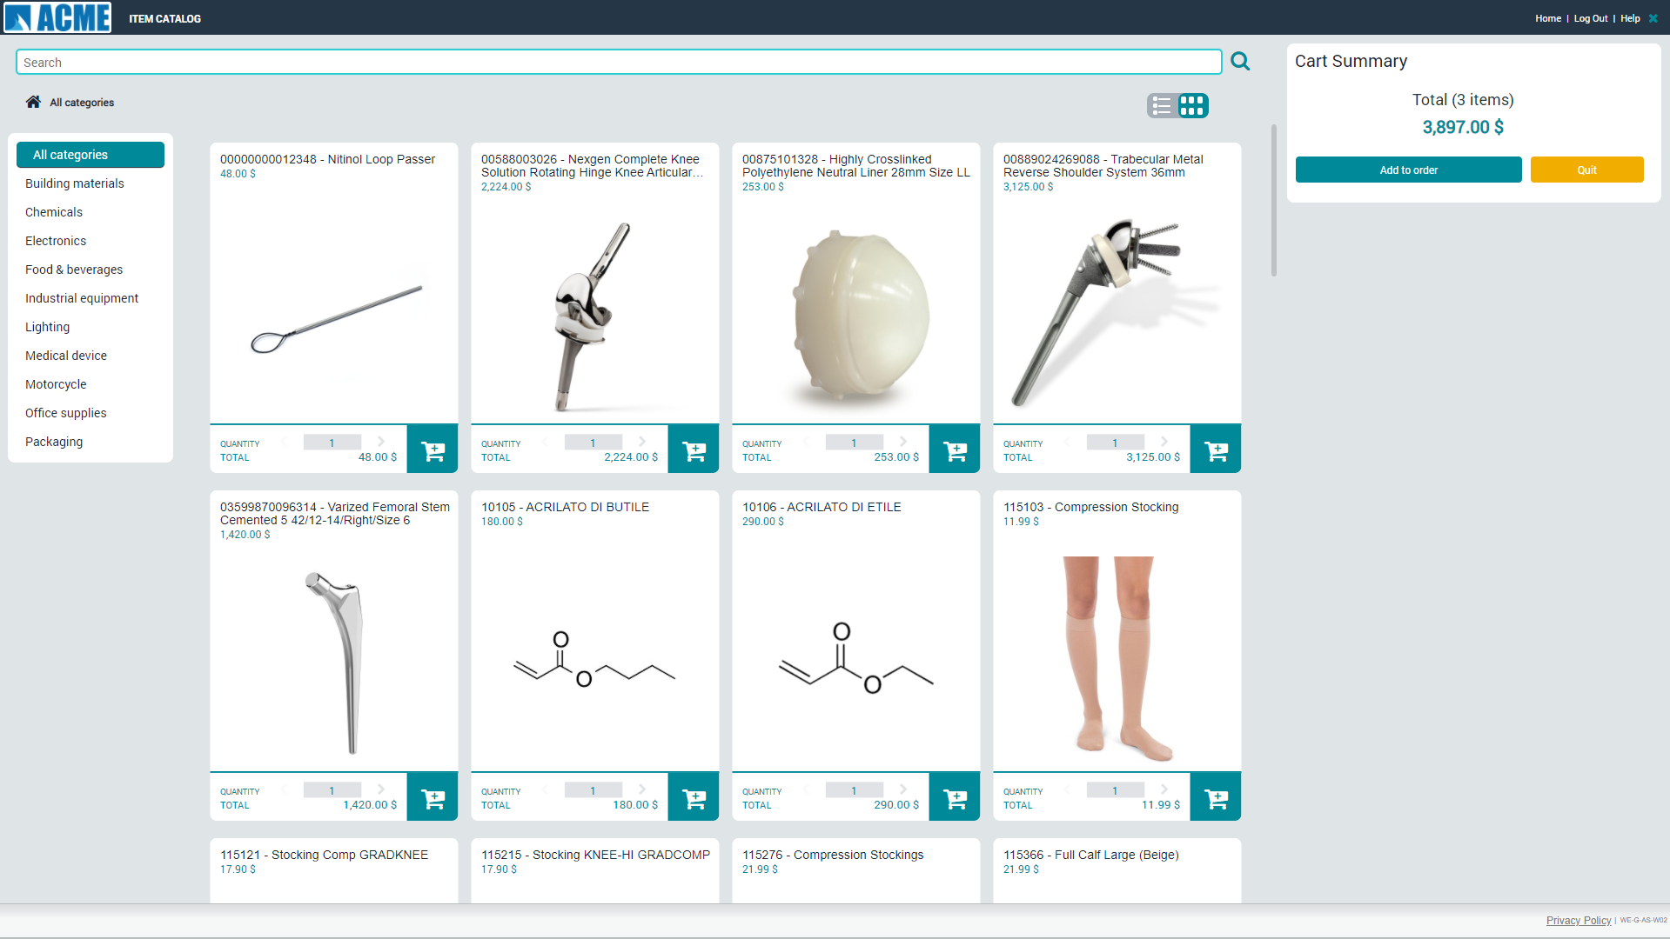


One Single Interface for All Orders
Regardless of reception channel & format
1
MULTICHANNEL
2
EDI
FAX
3
ERP
EMAIL
4
PDF
EXTERNAL PORTAL
& MARKETPLACE
5
TIFF
6
X12
E-COMMERCE
PORTAL
MOBILE APP
EDIFACT
MULTIFORMAT
IDOC
UBL
XML
JPG
EXCEL
WORD

Slide 9
AI-driven Data Recognition
FIRST TIME RECOGNITION
Extracting information from orders seen for the first time using deep learning technologies
DATA
EXTRACTION
AUTO-LEARNING
Machine learning technology increasing the recognition rates by learning from users’ corrections
TEACHING
Explicit definition of recognition criteria for specific recurring orders
TEXT EXTRACTION
for text-based documents
(Most System Generated PDFs)
OCR
for image-based documents
(e.g. Fax)
CHARACTER
EXTRACTION
DATA ANALYTICS
DATA ANALYTICS & BUSINESS INTELLIGENCE
to identify improvement areas or anomalies

Slide 10

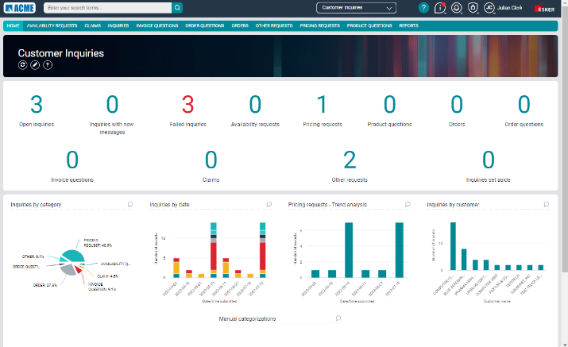

Augmented Customer Service
+
CUSTOMER INQUIRY SOLUTION
ORDER MANAGEMENT SOLUTION
Solutions run
hand-in-hand
Customer Service works
smarter, not harder
Customers get the best possible experience

Slide 11





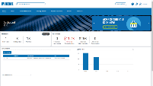
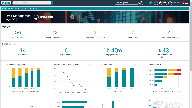
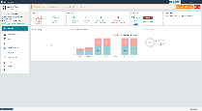
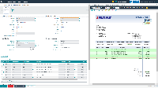
YOUR CUSTOMERS
Esker Cloud Environment
YOUR COMPANY
CHANNELS
SOLUTIONS
YOUR DATA
Email
EDI
Fax
3rd Party Portal
Mobile App
Esker Customer Portal
CUSTOMER INQUIRY MANAGEMENT
ORDER MANAGEMENT
CLAIMS & DEDUCTIONS
YOUR ERP
Customers & shipping addresses
Materials
Order confirmations
Shipping notices
Open AR
MASTER DATA REPLICATION
REQUESTS
SECURED CHANNEL
SFTP / EDI /API / Web Service
Product question
Pricing request
Availability request
Order
Order status
Claim
Etc.
Quotes
Orders
Cases
Return orders
Credit notes
powered by AI
SECURED CHANNEL
YOUR CRM (e.g. SalesForce
Customers
Cases
  Create
  Update
  Close
ARIBA
Tungsten
Coupa
SELF-SERVICE
ESKER CUSTOMER SERVICE INTERFACE
3rd Party Portals
Orders
Order Changes
Order Conf
ASN
Invoice
ARIBA
Tungsten
Coupa
ESKER CUSTOMER PORTAL
DASHBOARDS & ANALYTICS
CUSTOMER MANAGEMENT
VALIDATION & COLLABORATION
Inquiries
Orders
Order confirmations
Inquiries
Orders
Order confirmations
Shipping notices
Invoices
CoA
Shipping notices
Invoices
Claims

Slide 12

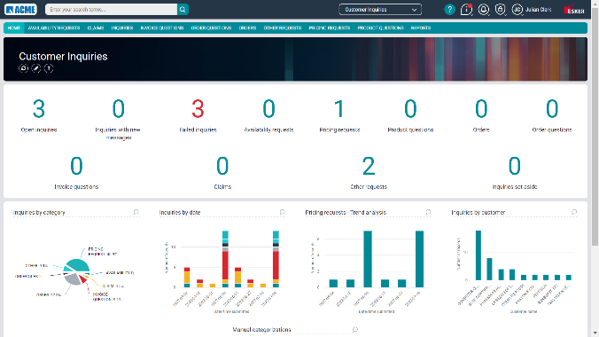
Customer Inquiry Automation
See everything, improve anything
Accelerate inquiry processing with Esker Synergy
AI Deep Learning
Enhance collaboration with internal & customer conversations
Improve customer experience & preserve a solid reputation
Increase employee satisfaction
Standard “Order, not an Order”
Advanced Classification
Auto Replies via ChatGTP
CRM/ERP Integration

Slide 13




EDI Workflow with ARIBA
End Customer
Esker Customer
Order/Order changes passed to Esker via cXML
Approved Order data to Supplier
Order Submission
Conversion to: human readable and/or X12
Order validation
Order Conf, ASN
855/856
Order Ack, ASN data
IDOC
SAP
Invoice Passed to customer or viewable on ARIBA Portal
Invoice Posted to Ariba
810
Invoice Submission
Customer Invoice (Customer copy) Process
Customer Invoice (Supplier Copy) Process
AR Batch Processing
Post confirmation sent to Esker

Slide 14


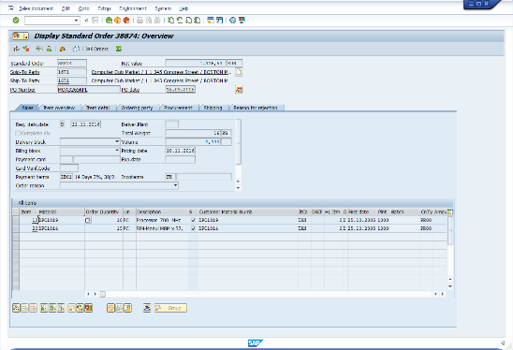

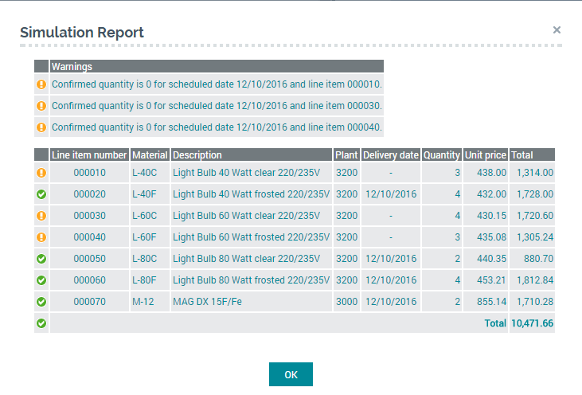
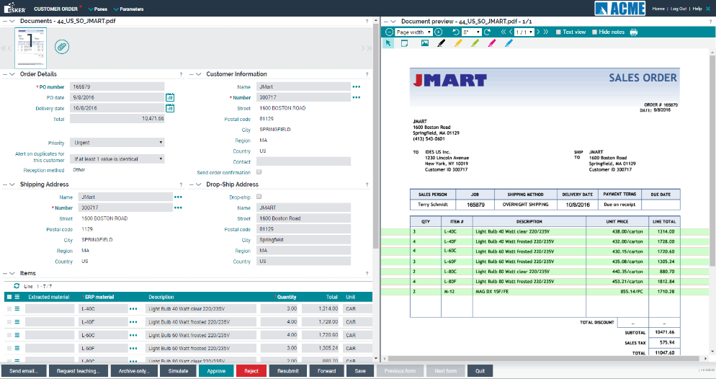


SAP Integration
RELIABLE INTEGRATION BASED ON BUSINESS APIS
FAST SETUP
& MINIMAL IT WORKLOAD
ECC or
S/4HANA
CONTINUOUS MAINTENANCE
& UPDATES
FEATURE SET
Live order simulation
Order creation in SAP
SAP order number acknowledgement
Master data live connection and/or automated synchronization
Document archive link in SAP

Slide 15

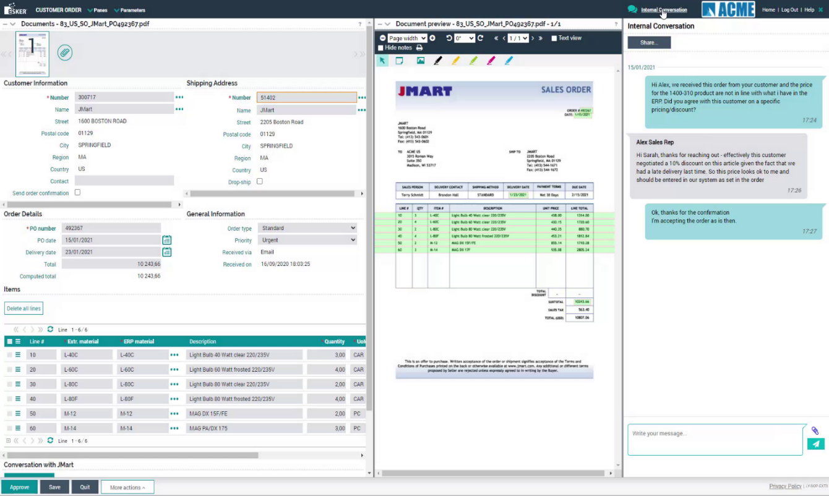
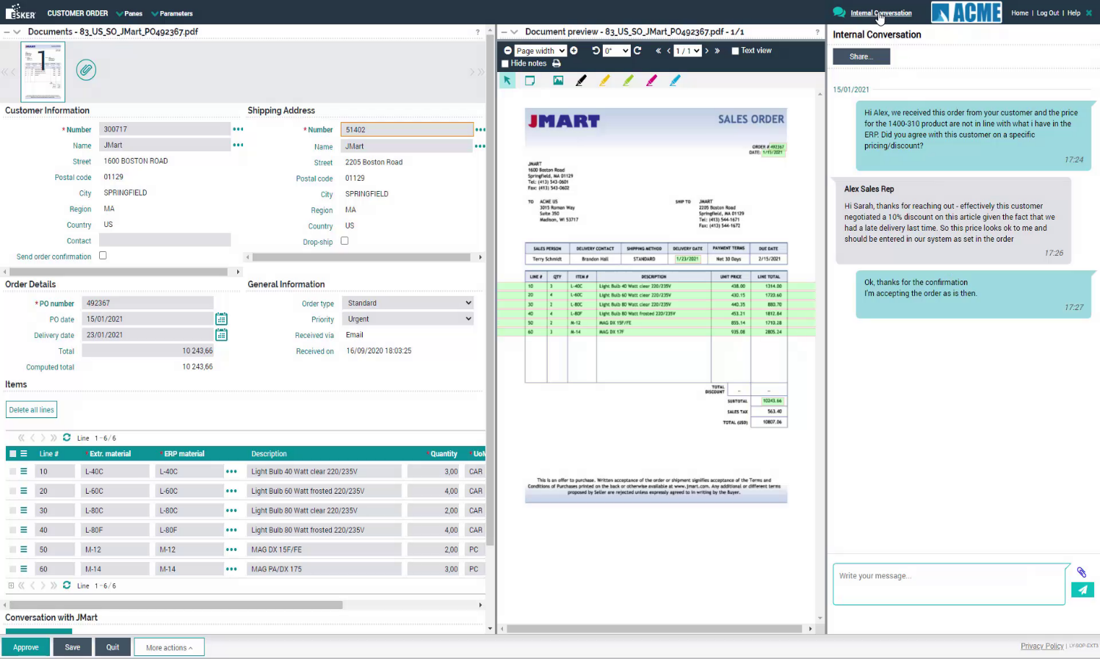
Combining human & artificial intelligence
Exception Validation
Original order image
Eased user review with original order image and extracted order data displayed side-by-side
Early indicators for awareness of potential duplicate order, order changes, anomaly detection, allocated items, unit of measure conversion.
Assisted and automatic data verification at the header & line-item level
Facilitated collaboration both internally and with customers to clarify orders
Automatic Data Capture
Early Indicators
e.g. Anomaly Detection
Internal
conversations
Customer
conversations
Notes:
Here is a quick preview of what the interface for CSRs, the main users of the solution, looks like and how artificial and human intelligence can join forces to provide the most efficient order management process.

Slide 16







One Solution For All Stakeholders
customer
CSR
CSR MANAGER
Sales rep
Supply chain director
CEO
Purchase and follow up on your orders 24/7
Process orders faster and more accurately
Build great customer experience
Look after your customers
Plan shipments ahead of time
Manage operations & monitor profitability
Notes:
But while this solution mostly helps customer service reps, it actually provides benefits to lots of different stakeholders involved or impacted by the order management process.

Slide 17



Our Customer Success Commitment
Esker customer events & user groups
Consult-a-pro webinars
Training &
on-line tutorials
Monthly newsletter & blog
Onsite & virtual visits
Engagement calls
VALUED ∙ understood ∙ engaged
THE BEST CUSTOMER EXPERIENCE
FROM DAY 1

Slide 18























Well-known brands run Esker
You’re in good company
Leading the way in the Chemical industry:
More than 450 total customers in over 60 countries

Slide 19



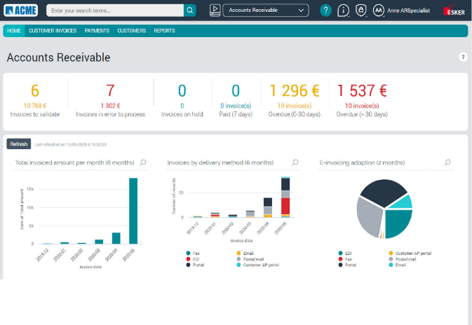
Process (Hyper)Automation
The Philosophy Behind ESKER
Focus
We offer the best user and customer experience on the market, year after year.
Customer satisfaction is our #1 priority.
Continuity
With 20+ years of experience in cloud computing, we serve over 1,500 customers, half of which have worked with us for 10 years or more.
Stability & Security
We bring security and reliability to your company's information with the latest technology and highest standards.
ISO 27001, SSAE 18 & ISAE 3402 certified.
Reputation
We are proud of our results and recognition. Our customers are happy to share their success stories and are available to provide references. We have nothing to hide.
Competition
We are the only platform
for P2P and O2C automation.
We build our growth on acquiring new customers and serving existing ones, rather than relying on extensive M&As
We’ll still be here for you in 10 years.
Experience
We offer one solution interface and a singular user experience, regardless of the number of different ERPs you may have.
No patchwork interfaces due to M&A with little to no integrations.
Notes:
When making the decision to automate your O2C and P2P processes, of course your primary focus will be selecting the most suitable and high-performing technology for your business.
In this case it makes sense to look back at when you chose your ERP system.
What was the thought- and decision-making process? Which key elements did you factor in when you ultimately chose the ERP for your business?
The same key elements are, of course, applicable for technology that will automate your P2P and O2C processes. This is a structuring process you will be engaging in, so it would not make sense to look at something that will at best serve you for the next 2-3 years. You should be looking at a provider that will be around for the next 10 years or more to ensure long-term continuity.
Continuity:
Esker has been in business for over 20 years and is now serving more than 1,500 customers — half of those for over 10 years. We’ve been around for a long time and will continue to be there for our customers for many years to come.
Stability & Security:
We are continuously working on maintaining the highest and latest security standards in order to better serve you. Securing your information and processes through a number of certifications and security standards is a continuous effort at Esker.
Reputation:
We are proud to say that Esker has a good reputation on the Business Process Automation market. Do not just take our word for it, however: don’t hesitate to ask for references! We’re happy to match you with companies that can share their experiences with you — for your location and industry.
The last two elements are crucial:
Competition & Experience:
We are the ONLY platform to serve the P2P and O2C cycles and with a single interface. Most of our growth comes from acquiring new customers or developing existing ones, as opposed to some of our competitors, whose growth is based MOSTLY on acquisition.
Not that there is anything wrong with growing through acquisition, but a patchwork solution would result in a poor user experience. The advantage of our solutions is that they are all integrated into one user-friendly interface for all P2P and O2C processes, regardless of the number of ERPs a company may have.
Esker’s focus has always been the customer experience, and it will always be our priority.

Slide 20
Order Automation in the Cloud
6 data centers
Multitenant
platform
HIPAA/HITECH compliance
ISO 27001, SSAE 18 & ISAE 3402 compliance
24/7 availability
Pay
as-you-go

Slide 21
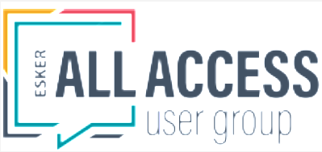
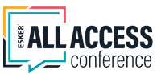
Upcoming Esker Customer Events
Esker All Access User Group for Order Management
4/25/23 to 4/26/23
Broomfield, CO
Viega Seminar Center
2023 Esker All Access Conference
9/11/23 to 9/13/23
Madison, WI
Madison Concourse Hotel
Register Here
Register Here
https://get.esker.com/eaa-user-group-order-management-april-2023/
https://whova.com/portal/registration/eaac_202309/

Slide 22
Thank you
for your attention
MARK ANDERSEN
mark.andersen@esker.com

