Slide 1
Work-life balance
How are you doing?

Slide 2
Let’s start with some humor…

Slide 3
What does work-life balance mean to you?

Slide 4
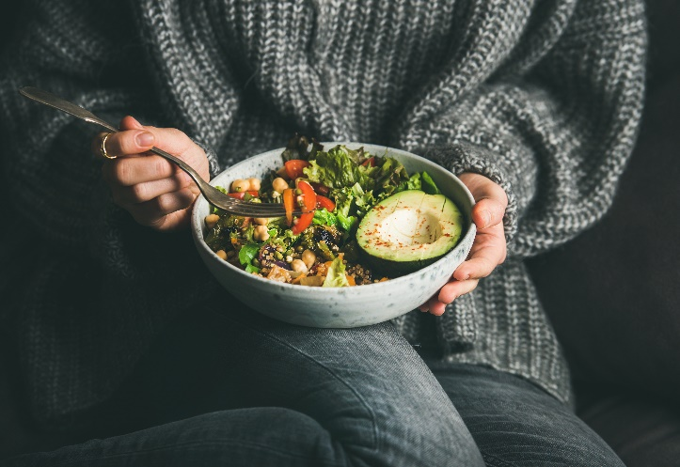
How do you eat healthy at work?

Slide 5
Smart Ways to Eat Healthier at Work
Keep it simple – focus on healthy meals that can be prepared in about 30 minutes
Always eat breakfast, a balanced diet, and 5-6 small meals a day
Meal prep for at least 3 days ahead
Dramatically reduce simple sugars
Stay hydrated and awake with water (4-5 12 oz glasses daily)
Snack smart (combining carbs and protein) and plan for those 3pm cravings

Slide 6
How do you sneak in exercise throughout the day?

Slide 7
Tips to Sneak Exercise into Your Day
Block your calendar for breaks so that people know when you will be away.
Keep exercise equipment (i.e. hand weights, exercise mats, resistance bands) nearby so you can build strength for a few minutes during your breaks.
Don’t have any exercise equipment? Build strength by walking, running, or doing exercises that require only your body weight.
Use health apps or smart devices to remind you when to get moving.
Schedule and prioritize workouts along with your work (4-5 cardiovascular workouts, 2-3 weight training workouts per week).
Take walking conference calls around the house or outside when video is not being used.

Slide 8
Creating balance At Work
Set manageable goals each day.
Be efficient with your time at work.
Ask for flexibility.
Take five.
Be present.
Communicate effectively.
Give yourself a break.

Slide 9
Tips to Have More Energy at Work
1. Stick to a regular schedule to help you feel normalcy during this uncertain time.
2. Take a shower in the morning and start the day just as you would to go in the office.
3. Take regular breaks (1- minutes every 90120 minutes).
4. Take a quick walk outside in between meetings to get some fresh air.
5. Workout 20 minutes or more mid-day.
6. Get enough sleep (7.5 – 8.5 hours each night) and set a regular sleep schedule, even on weekends.
7. Go to bed early and wake up early; establishing new sleep rituals is possible.
8. Take a power nap during the day if needed.

Slide 10
Tips to Manage Stress
1. Learn anything new and find positive distractions to help you overcome mental exhaustion.
2. Become more conscious of emotional triggers.
3. Step away or enlist an ally to help you control your reactions and choose your response.
4. Spend 5 minutes doing deep-breathing exercises once in the morning and again in the afternoon.
5. Cultivate kindness by doing something nice for someone else.
6. Create a gratitude journal, meditate, pray, and/or act in service of others.

Slide 11
Tips to Strengthen Resiliency
Interact
Interact with others throughout your day by using communication tools to help you stay engaged.
Communicate
Communicate how you are doing and keep others up to date to maintain trust with teammates.
Address
Address issues immediately so they can be resolved as they happen, and always with the best interest of those involved in mind.
Advice
Ask for advice, give positive feedback, or share something you recently learned about yourself.
Gratitude
Practice gratitude and help others however you can, even in small ways.
Breaks
Take detachment breaks, using evening and taking time off the recharge.

Slide 12
Creating balance At home
Unplug.
Divide and conquer.
Don't over commit.
Get support.
Take advantage of your company’s Employee Assistance Program (EAP).
Stay active.
Treat your body right.
Get help if you need it.

Slide 13
Tips for Improving Work-Life Balance
Let go of perfectionism
Accept 80% and adjust as necessary – perfect takes too long.
Unplug
Disconnect and store technology devices far from your bed.
Exercise
For at least 20-30 minutes daily.
Limit time-wasting activities and people.
Prioritize what is important.
Change the structure of your life
What could make your life easier?
Start small
Create measurable goals. Build from there.

Slide 14
Thank you!

Slide 15
What are you going do to enjoy the holiday season?

