Slide 1
Communication Work Styles
April 2021 – Webinar
Instructor Guide

Slide 2
WELCOME and Let’s…
…with CCSMG

Slide 3
Understand Communication Styles
Directions to uncover YOUR Communication Work Style:
Working horizontally left to right.
Mark a # 5 next to the word on each line, that describes your ON THE JOB behavior at least 80% of the time.
Mark a # 1 next to the word on each line, that describes your ON THE JOB behavior at least 20% of the time.
You should only have one number 5 and one number 1 on each line.
Total the number of each column and write the number in the space provided.

Slide 4
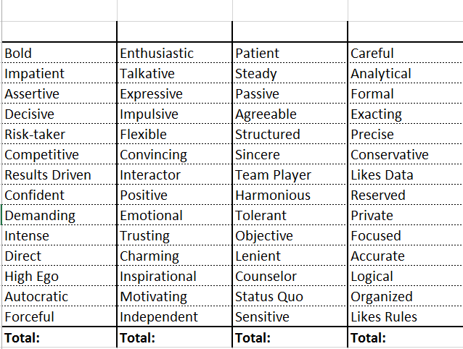
Communication Work Style Check
CHARGER
SOCIALIZER
HARMONIZER
THINKER
5
1
What is your primary style?
5
1
What is your secondary style?

Slide 5
Understand Communication Styles
CHARGER
Their value to the team:
Phone style:
Listening style:
Irritated by:
When angry:
Directives / Rules:
Wants you to be:
Worst way to treat them:
Possible miss-perception by others:
Leadership – Results driven
Direct – Rushed - Abrupt
Listen to key words – Highly selective
Slacker – Inefficiency - Indecision
This style likes to be in control. They are direct, and action oriented. They focus on getting results. They like and cause change. Under stress, they sometimes tread on others without realizing it.
Easy to tell when angry
Likes to make rules
Direct
Baby them – Don’t micromanage
Don’t care - Pushy

Slide 6
Understand Communication Styles
SOCIALIZER
Their value to the team:
Phone style:
Listening style:
Irritated by:
When angry:
Directives / Rules:
Wants you to be:
Worst way to treat them:
Possible miss-perception by others:
Motivation - Ideas
Talkative
Worst listeners
No one to talk to – Unfriendly people
This style wants and needs group interaction. They are very trusting and optimistic. They are fun to be around, and are excellent motivators. This style talks the most and can be impulsive.
Shows silence - Sarcasm
Don’t like rules – should be free
Flexible - Options
Ignore them
Lazy – Flighty – Party animal

Slide 7
Understand Communication Styles
HARMONIZER
Their value to the team:
Phone style:
Listening style:
Irritated by:
When angry:
Directives / Rules:
Wants you to be:
Worst way to treat them:
Possible miss-perception by others:
Details - Loyalty
Patient - Warm
Best listener
Confrontation - Change
This style has strong attachments to family and friends. They are very slow to change their loyalties. They blend the best with all of the other styles. Under stress this style can become very passive.
You won’t know if they are angry
Loves rules – Needs stability
Respectful
Be obnoxious - Argue
No backbone – Not smart

Slide 8
Understand Communication Styles
THINKER
Their value to the team:
Phone style:
Listening style:
Irritated by:
When angry:
Directives / Rules:
Wants you to be:
Worst way to treat them:
Possible miss-perception by others:
Details - Accuracy
Direct - Formal
Good – Strong basis with details & facts
Assumptions – Chaos - Disorganization
This style believes in and follows rules. They like systems, predictability, tradition and quality control. They trust people the least and are the most private. They like back-up data and do not like to make mistakes. They take criticism of their work personally.
You won’t know if they are angry
Loves rules – Organizer
Organized – Factual - Correct
Talk down - Criticism
Loners – Cold – Know it all’s

Slide 9
Treating people as individuals is your key to exceptional communications.

