Slide 1
Back to Basics
For building customer relationships
CCSMG 2023 SPRING CONFERENCE

Slide 2
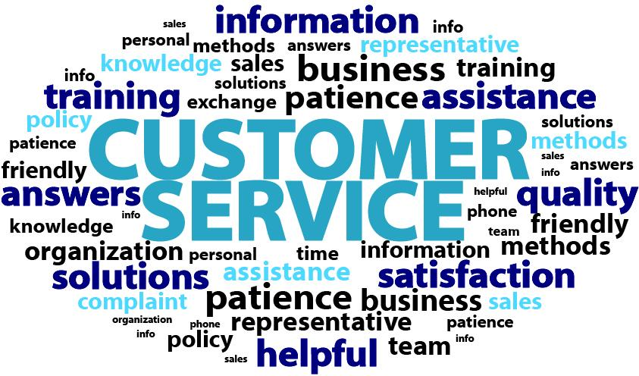
“The customer experience is the next competitive battleground.” Jerry Gregoire

Slide 3
8 back to basic Tips for building customer relationships
Know What Your Customers Expect
Develop a Positive Team Attitude
Understand Communication Styles
Demonstrate Active Listening
Practice Positive Telephone Techniques
Utilize Word Power
Keep Your Cool Under Stress
Rules to Remember

Slide 4
Tip #1: Know what your customers expect
What your customers expect:
Basic Customer Expectations / The 5 R’s
Rapport
Recognition
Reliability
Respect
Resolution
2. How they get their expectations:
Word of mouth
Competition
Consistency in services
Contracts / Sales Agreements
Reliability
“When in doubt, tell the truth.” Mark Twain

Slide 5
Tip #2: Build a positive team attitude
Answer
Yes or No
Are you enthusiastic about your job?
Are you a supportive co-worker?
Do you coach others when necessary?
Do you make an extra effort to remember names?
Do you naturally smile a lot?
Are you fun to work with?
Would you choose to work with YOU on a team?
Do you share information with co-workers to them do a better job?
Do you often make positive statements about your organization?
Do you genuinely like people?
Positive Attitude

Slide 6
Tip #2: Build a positive team attitude
Your commitment to customer service starts at the heart.
IT’S UP TO YOU!
7 Ways to build a positive attitude:
Be flexible and try to see things through the other person’s eyes.
Use humor…make your job fun!
Show enthusiasm for your job.
Smile, it’s contagious.
Take job ownership.
Replace criticism with positive ideas.
Be a coach.
Positive Attitude
“A smile is the shortest distance between two people.” Victor Borge

Slide 7
Tip #2: Build a positive team attitude
E + R = O
Event + Response = Outcome
Positive Attitude
Your response is KEY to your attitude.
“I am” are the strongest two words.

Slide 8
Tip #3: understand communication styles
Work Style Check Exercise:
Working horizontally left to right.
Mark a # 5 next to the word on each line, that describes your ON THE JOB behavior at least 80% of the time.
Mark a # 1 next to the word on each line, that describes your ON THE JOB behavior at least 20% of the time.
You should only have one number 5 and one number 1 on each line.
Total the number of each column and write the number in the space provided.
Flexibility
What is your primary and secondary style?

Slide 9
Tip #3: understand communication styles
CHARGER
Their value to the team:
Phone style:
Listening style:
Irritated by:
When angry:
Directives / Rules:
Wants you to be:
Worst way to treat them:
Possible miss-perception by others:
Flexibility
Treating people as individuals is your key to exceptional customer service.

Slide 10
Tip #3: understand communication styles
SOCIALIZER
Their value to the team:
Phone style:
Listening style:
Irritated by:
When angry:
Directives / Rules:
Wants you to be:
Worst way to treat them:
Possible miss-perception by others:
Flexibility
Treating people as individuals is your key to exceptional customer service.

Slide 11
Tip #3: understand communication styles
HARMONIZER
Their value to the team:
Phone style:
Listening style:
Irritated by:
When angry:
Directives / Rules:
Wants you to be:
Worst way to treat them:
Possible miss-perception by others:
Flexibility
Treating people as individuals is your key to exceptional customer service.

Slide 12
Tip #3: understand communication styles
THINKER
Their value to the team:
Phone style:
Listening style:
Irritated by:
When angry:
Directives / Rules:
Wants you to be:
Worst way to treat them:
Possible miss-perception by others:
Flexibility
Treating people as individuals is your key to exceptional customer service.

Slide 13
Tip #4: Demonstrate Active listening
7 Reasons we don’t hear the message:
Preoccupied with personal issues
Preoccupied with job
Stressed out
Ill / sick
Disinterested
Distractions (noise, environment, phone, co-workers)
Lack of knowledge
Can you think of anything else that could affect how you hear the message?
Accuracy
“Big people monopolize the listening. Small people monopolize the talking.” – David Schwartz

Slide 14
Tip #4: Demonstrate Active listening
16 Active Listening Habits:
Focus your attention
Do not interrupt
Let them finish
Do not put words in their mouth
Focus on main points
Take a few notes if possible
Sit squarely postured
Do not let personal feelings interfere
Ignore “loaded words or statements”
Ask them to slow down, if necessary
Naïve listening (play dumb)
Verbal attending
Ask questions
Listen for emotion
Don’t let emotion shake you
Paraphrase (use your own words) *
Accuracy
* Fastest way to good listening skills

Slide 15
Tip #5: positive telephone techniques
12 Telephone Taboos:
Negative / uncaring attitude
No knowledge, or “no one is here right now that can help you”
Making excuses
The transfer syndrome
Making promises for others
Sarcastic or negative voice tone
Speaker Phone
Long holds
Call ME Back
Unreturned calls
No authority
No follow through
Check your voice quality
Critique yourself: Ask, “If I heard this voice on the telephone,
what impression(s) would I have.”
Responsiveness
Group exercise: Check for others energy, speed, pitch, volume, and number and length of pauses

Slide 16
Tip #6: utilize word power
Stay Away From: | Restate:
Problem
Unfortunately, I can’t, No
You have to
Terms of endearment
I’m sorry
Calm down
I can’t / I’ll try
That’s fine, BUT
Avoid Robotronics: No Problem and Have a nice day
Trust & Sincerity

Slide 17
Tip #6: utilize word power
What your customer likes to hear:
Thank you for letting me know
Thank you for calling this to our attention
Thank you for your patience
Let me take some notes about what needs to be done
I will be happy to assist you
Give your customers a personal commitment:
I will take personal responsibility for seeing that this is handled, and I’ll get back to you by ______. (Under Promise, Over Deliver)
I have to do more research to get you that information, Mrs. Smith. I will call you back this afternoon by 3:00, OK? (Under Promise, Over Deliver)
Trust & Sincerity
Remember: When you have proposed an action of any kind to a customer, follow it up in an e-mail. This is documentation that alleviates mistakes and makes the customer feel important.

Slide 18
Tip #7: Keep your cool under stress
Techniques to remain calm with a distress customer
Silence if they are enraged | Let them vent
Stay calm | Apologize if appropriate and sincere
Never try to justify why | No “finger pointing”
Use good listening techniques | Get the facts and document
Lower your voice | Stand up
Never argue | Use a positive approach
Follow through | Take call ownership
What other techniques do you use?
Solutions & Resolutions
“Problems are not stop signs, they are guidelines.” Robert Schuller

Slide 19
TIP #8: Rules to remember
Don’t steal someone else’s line.
You can’t let the way you feel determine the way you act.
Let the way you act determine the way you feel.
We are responsible for our customers experience.

Slide 22
NOTES:

