Slide 1
Back to Basics
Instructors Guide
For building customer relationships
Be sure to read the quotes as they could have a lasting impact on the Tip that is being discussed. There is a quote on the last page of each Tip.
CCSMG 2023 SPRING CONFERENCE

Slide 2
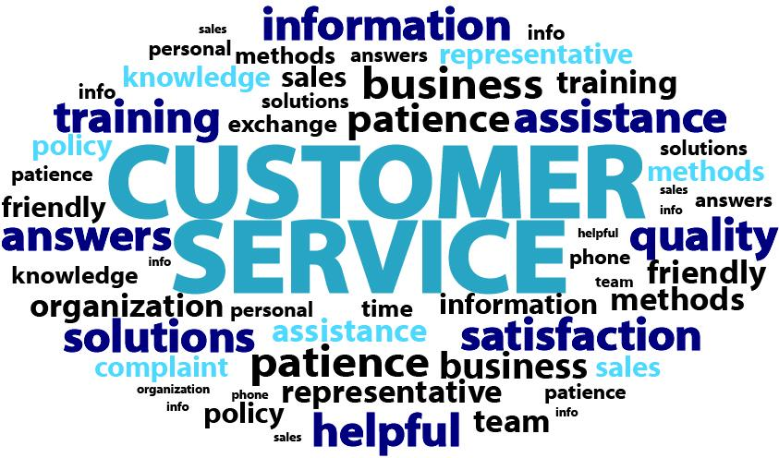
“The customer experience is the next competitive battleground.” Jerry Gregoire
In this session of Back to Basics, this word cloud represents some of the key aspects we will review. Example: Satisfaction, Solutions, Helpful, etc.

Slide 3
8 back to basic Tips for building customer relationships
Know What Your Customers Expect
Develop a Positive Team Attitude
Understand Communication Styles
Demonstrate Active Listening
Practice Positive Telephone Techniques
Utilize Word Power
Keep Your Cool Under Stress
Rules to Remember

Slide 4
Tip #1: Know what your customers expect
It is helpful to remember that customers tend to remember the unexpected – either exceptional service or poor service – and ignore and forget average service. Review every 6 months
What your customers expect:
Basic Customer Expectations / The 5 R’s
Rapport | Relationship
Recognition (Compliment) | Responsiveness (now)
Reliability (Keep promises) | Assurance (Knowledge / Courtesy)
Respect (Receive same level of service) | Empathy (Care)
Resolution (Follow-up calls) | Outcome
Should review the 5 R’s at least twice a year as a refresher.
2. How they get their expectations:
Word of mouth
Competition
Consistency in services
Contracts / Sales Agreements
Ask audience for other ways they feel customers get their expectations. Examples: Media, Certifications / Awards
Reliability
“When in doubt, tell the truth.” Mark Twain

Slide 5
Tip #2: Build a positive team attitude
Answer
Yes or No
Are you enthusiastic about your job?
Are you a supportive co-worker?
Do you coach others when necessary?
Do you make an extra effort to remember names?
Do you naturally smile a lot?
Are you fun to work with?
Would you choose to work with YOU on a team?
Do you share information with co-workers to them do a better job?
Do you often make positive statements about your organization?
Do you genuinely like people?
Positive Attitude
Read the question to the audience and have them answer each one YES or NO. For every YES, they are to give themselves 1 point….add up the total points.
If total score is 7 that is average / > 7 is a positive person / < 7 they will need to regroup and work on improving to be a positive person

Slide 6
Tip #2: Build a positive team attitude
Your commitment to customer service starts at the heart.
IT’S UP TO YOU!
7 Ways to build a positive attitude:
Be flexible and try to see things through the other person’s eyes.
Use humor…make your job fun!
Show enthusiasm for your job.
Smile, it’s contagious.
Take job ownership.
Replace criticism with positive ideas.
Be a coach.
Positive Attitude really is a reflection of the commitment you have…and begins with your heart. If your heart isn’t in the job, others can feel that. Stress the importance of owning their attitudes and feeling the job from within.
Positive Attitude
“A smile is the shortest distance between two people.” Victor Borge

Slide 7
Tip #2: Build a positive team attitude
E + R = O
Event + Response = Outcome
If you could only remember one thing from this session, this is the thing to remember….as your response/actions will influence the outcome. Describe a scenario to stress the importance of ones response/actions.
Positive Attitude
Your response is KEY to your attitude.
“I am” are the strongest two words.

Slide 8
Tip #3: understand communication styles
Pass out the communication style worksheet for this exercise. See separate file for this worksheet.
Work Style Check Exercise:
Working horizontally left to right.
Mark a # 5 next to the word on each line, that describes your ON THE JOB behavior at least 80% of the time.
Mark a # 1 next to the word on each line, that describes your ON THE JOB behavior at least 20% of the time.
You should only have one number 5 and one number 1 on each line.
Total the number of each column and write the number in the space provided.
Flexibility
What is your primary and secondary style?

Slide 9
Tip #3: understand communication styles
CHARGER
Their value to the team: Leadership – Results
Phone style: Direct – Rushed – Abrupt
Listening style: Listen to key words – highly selective
Irritated by: Slacker – Inefficiency – Indecision
When angry: Easy to tell when angry
Directives / Rules: Likes to make rules
Wants you to be: Direct
Worst way to treat them: Baby them / don’t micromanage
Possible miss-perception by others: Don’t care - Pushy
Charger: This style likes to be in control. They are direct, and action oriented. They focus on getting results. They like and cause change. Under stress, they sometimes tread on others without realizing it.
Flexibility
Treating people as individuals is your key to exceptional customer service.

Slide 10
Tip #3: understand communication styles
SOCIALIZER
Their value to the team: Motivation – Ideas
Phone style: Talkative
Listening style: Worst listeners
Irritated by: No-one to talk to – Unfriendly people
When angry: Shows silence – Sarcasm
Directives / Rules: Don’t like rules – should be free
Wants you to be: Flexible - Options
Worst way to treat them: Ignore them
Possible miss-perception by others: Lazy – Flighty – Party animal
Socializer: This style wants and needs group interaction. They are very trusting and optimistic. They are fun to be around, and are excellent motivators. This style talks the most and can be impulsive.
Flexibility
Treating people as individuals is your key to exceptional customer service.

Slide 11
Tip #3: understand communication styles
HARMONIZER
Their value to the team: Details – Loyalty
Phone style: Patient – Warm
Listening style: Best listener
Irritated by: Confrontation – Change
When angry: You won’t know if their angry
Directives / Rules: Loves rules – Needs stability
Wants you to be: Fair – Respectful
Worst way to treat them: Be obnoxious – Argue
Possible miss-perception by others: No backbone – Not smart
Harmonizer: This style has strong attachments to family and friends. They are very slow to change their loyalties. They blend the best with all of the other styles. Under stress this style can become very passive.
Flexibility
Treating people as individuals is your key to exceptional customer service.

Slide 12
Tip #3: understand communication styles
THINKER
Their value to the team: Details – Accuracy
Phone style: Direct – Formal
Listening style: Good – Strong basis with details & facts
Irritated by: Assumptions – Ciaos –Dis-organization
When angry: You won’t know if they are angry
Directives / Rules: Loves rules – Organizer
Wants you to be: Organized – Factual – Correct
Worst way to treat them: Talk down – Criticism
Possible miss-perception by others: Loners – cold – Know it all's
Thinker: This style believes in and follows rules. They like systems, predictability, tradition and quality control. They trust people the least and are the most private. They like back-up data and do not like to make mistakes. They take criticism of their work personally.
Flexibility
Treating people as individuals is your key to exceptional customer service.

Slide 13
Tip #4: Demonstrate Active listening
7 Reasons we don’t hear the message:
Preoccupied with personal issues
Preoccupied with job
Stressed out
Ill / sick
Disinterested
Distractions (noise, environment, phone, co-workers)
Lack of knowledge
Can you think of anything else that could affect how you hear the message?
Accuracy
“Big people monopolize the listening. Small people monopolize the talking.” – David Schwartz

Slide 14
Tip #4: Demonstrate Active listening
16 Active Listening Habits:
Focus your attention
Do not interrupt
Let them finish
Do not put words in their mouth
Focus on main points
Take a few notes if possible
Sit squarely postured
Do not let personal feelings interfere
Ignore “loaded words or statements”
Ask them to slow down, if necessary
Naïve listening (play dumb)
Verbal attending
Ask questions
Listen for emotion
Don’t let emotion shake you
Paraphrase (use your own words) *
Accuracy
* Fastest way to good listening skills

Slide 15
Tip #5: positive telephone techniques
12 Telephone Taboos:
Negative / uncaring attitude
No knowledge, or “no one is here right now that can help you”
Making excuses
The transfer syndrome
Making promises for others
Sarcastic or negative voice tone
Speaker Phone
Long holds
Call ME Back
Unreturned calls
No authority
No follow through
Check your voice quality
Critique yourself: Ask, “If I heard this voice on the telephone,
what impression(s) would I have.”
Responsiveness
Group exercise: Check for others energy, speed, pitch, volume, and number and length of pauses

Slide 16
Tip #6: utilize word power
Stay Away From: | Restate:
Problem | Issue – Concern – Situation
Unfortunately, I can’t, No | What I will do / What you can do is
You have to | Would it be possible if you
Terms of endearment (honey, sweetie) | Proper Name
I’m sorry | I apologize – don’t over apologize
Calm down | Take note – understand
I can’t / I’ll try | Here is what I can do
That’s fine, BUT | That’s fine; and; limit conjunctives
Avoid Robotronics: No Problem and Have a nice day
Trust & Sincerity

Slide 17
Tip #6: utilize word power
What your customer likes to hear:
Thank you for letting me know
Thank you for calling this to our attention
Thank you for your patience
Let me take some notes about what needs to be done
I will be happy to assist you
Give your customers a personal commitment:
I will take personal responsibility for seeing that this is handled, and I’ll get back to you by ______. (Under Promise, Over Deliver)
I have to do more research to get you that information, Mrs. Smith. I will call you back this afternoon by 3:00, OK? (Under Promise, Over Deliver)
Phone or E-mail
Trust & Sincerity
Remember: When you have proposed an action of any kind to a customer, follow it up in an e-mail. This is documentation that alleviates mistakes and makes the customer feel important.

Slide 18
Tip #7: Keep your cool under stress
Techniques to remain calm with a distress customer
Silence if they are enraged | Let them vent
Stay calm | Apologize if appropriate and sincere
Never try to justify why | No “finger pointing”
Use good listening techniques | Get the facts and document
Lower your voice | Stand up
Never argue | Use a positive approach
Follow through | Take call ownership
Don’t say: “Calm down” or “I know how you feel.”
Say – “I am” these are the strongest words you can say.
What other techniques do you use?
Solutions & Resolutions
“Problems are not stop signs, they are guidelines.” Robert Schuller

Slide 19
TIP #8: Rules to remember
Don’t steal someone else’s line.
Have them write in the most important Tip from this session….E + R = 0.
You can’t let the way you feel determine the way you act.
Let the way you act determine the way you feel.
We are responsible for our customers experience.

Slide 22
NOTES:

Slide 23
NOTES:

Slide 24
NOTES:

