Slide 1
The Evolution of Customer Service Through Generative AI
ROUNDTABLE DISCUSSION
April 17th

Slide 2
Traditional AI vs. Generative AI
Traditional AI (Narrow or Weak AI):
Focus: Traditional AI is designed for specific tasks, and it operates within its programmed boundaries
Function: It responds to predefined inputs and follows rules. For instance:
Voice assistants (like Siri or Alexa) follow specific commands.
Recommendation engines on platforms like Netflix or Amazon suggest content.
Generative AI (The Next Frontier):
Definition: Generative AI is like the imaginative friend who creates something fresh.
Example: Imagine giving an AI a starting line for a story, like “Once upon a time, in a galaxy far away…”. The AI then spins an entire space adventure with characters, plot twists, and a thrilling conclusion. It generates original content.
Capabilities:
Text: Generative AI can create human-like text.
Images & Music: It can generate images and composes tunes.
In summary, while traditional AI analyzes existing data and makes predictions, generative AI takes it a step further by creating new content. It’s like having an AI friend who’s both smart and creative!

Slide 3
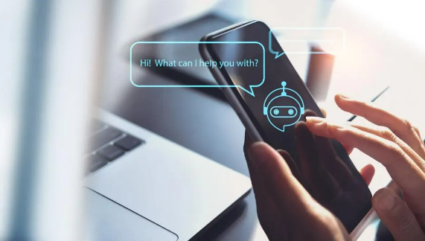
Generative AI and Customer Service
Customer service is proving to be one of the most popular applications of generative AI.
But how exactly can generative AI aid customer service teams (without alienating customers)?

Slide 4
The Common Use of Generative AI
One of the obvious uses of generative AI is customer-facing chatbots. If you’ve ever had a frustrating interaction with a chatbot that is not particularly helpful, take heart because, with tools like ChatGPT, organizations can create chatbots that better understand customer queries and respond with much greater accuracy and nuance. They can also handle a large volume of queries efficiently and provide more personalized responses over time.

Slide 5
Advantages of Using AI in Customer Service
Improve Efficiency
Eliminating time-consuming, repetitive tasks
Enables analysis of customer interactions
Optimizing data to support CS operations
Provides 24/7 Customer Service
Deliver Quick & Personalized Support
Offer Multilingual Support
Deliver Realistic Conversations
Extracting Data-Driven Insights
Cost Savings
Reduces labor costs associated with hiring and training
78% of customer service professionals say AI and automation tools help them spend time on more important aspects of their role.

Slide 6
Challenges & Limitations of Using AI in Customer Service
Emotional Intelligence
AI lacks the emotional intelligence and nuanced communication skills that human agents possess. Customers often appreciate empathy and understanding, which AI struggles to replicate.
Personal Interaction
Highly automated AI responses can make customers feel disconnected. Traditional customer service involves personal interactions, and AI may not fully replace that.
Bias and Fairness
AI systems can inadvertently exhibit bias, leading to unfair or discriminatory treatment of specific groups. Ensuring fairness is a challenge.
Complex Scenarios
While rule-based AI works for basic inquiries, handling complex, unpredictable customer behavior requires more advanced AI techniques like machine learning.
Adaptability
Current chatbots often fall short because they rely on rigid rules. Machine learning aims to make AI adaptable and responsive, learning from historical interactions.

Slide 7
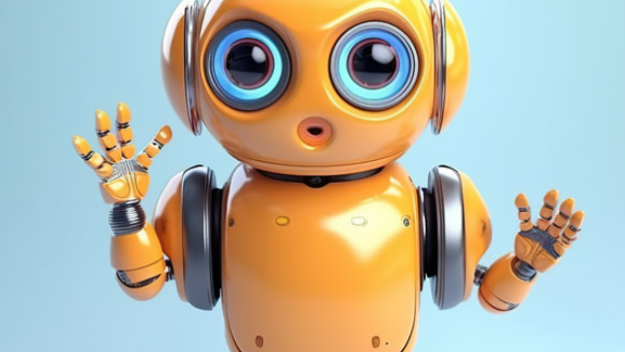
What are your plans for AI?

Slide 8
In Summary…
In summary, while AI offers significant benefits, it’s essential to strike a balance between automation and human touch in customer service. Companies must consider the context, complexity, and emotional aspects of interactions when deciding how to integrate AI into their support systems.
As AI technology advances, we can expect to see even more innovative and effective uses in customer service.
The future is promising, and it's clear that AI will play a pivotal role in shaping how businesses interact with and serve their customers.

